Slide 1
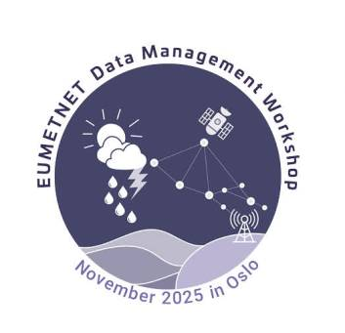
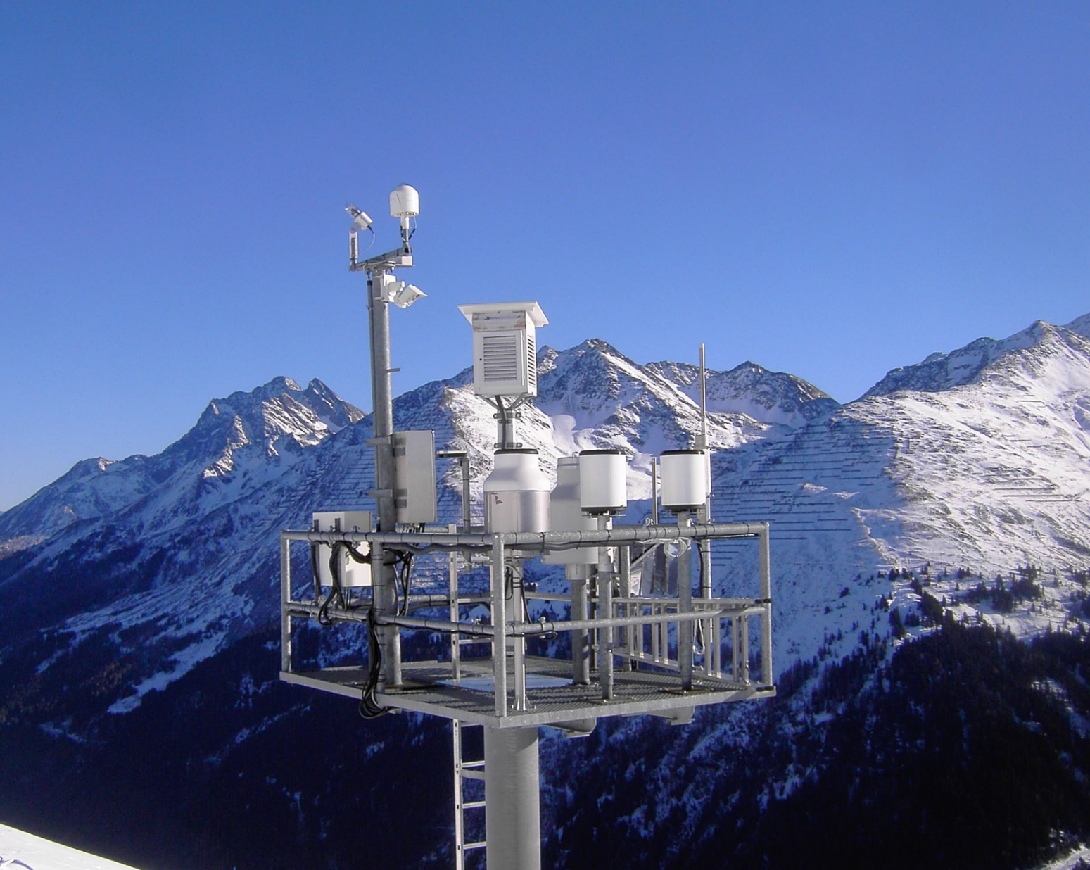
Quality Control of Precipitation Data @ GeoSphere Austria Data Quality and Digitization Niko Filipovic*, Anita Paul, Geyer Florian
15th EUMETNET Data Management Workshop, Oslo 2025
*niko.filipovic@geosphere.at
Station Galzig © GeoSphere Austria

Slide 2
Outline
Precipitation measurement network at GeoSphere Austria
Instruments and methods
Introduction of the automated Quality Control tool AQUAS
Brief overview of the system structure
Precipitation data Quality Control (QC) (without flagging system)
main check-functions
focus on weighing gauges
Recent work:
Automated error detection method for weighing bucket precipitation gauge records
Application in operational use

Slide 3
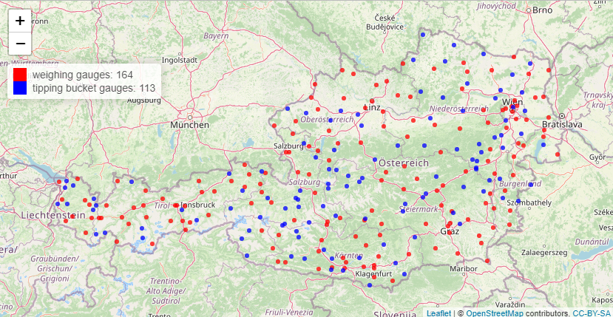
1. Precipitation measurement network @ GeoSphere Austria
Temporal resolution: 1 minute

Slide 4
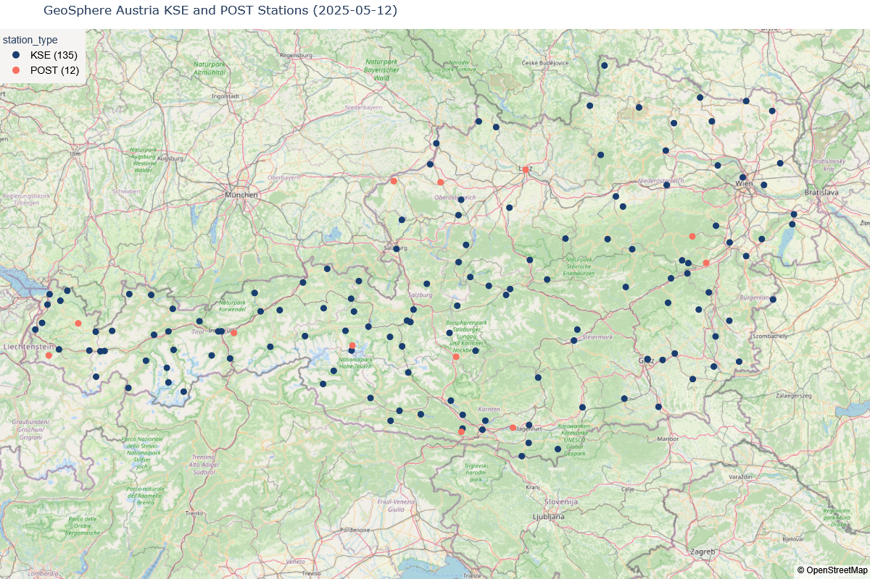
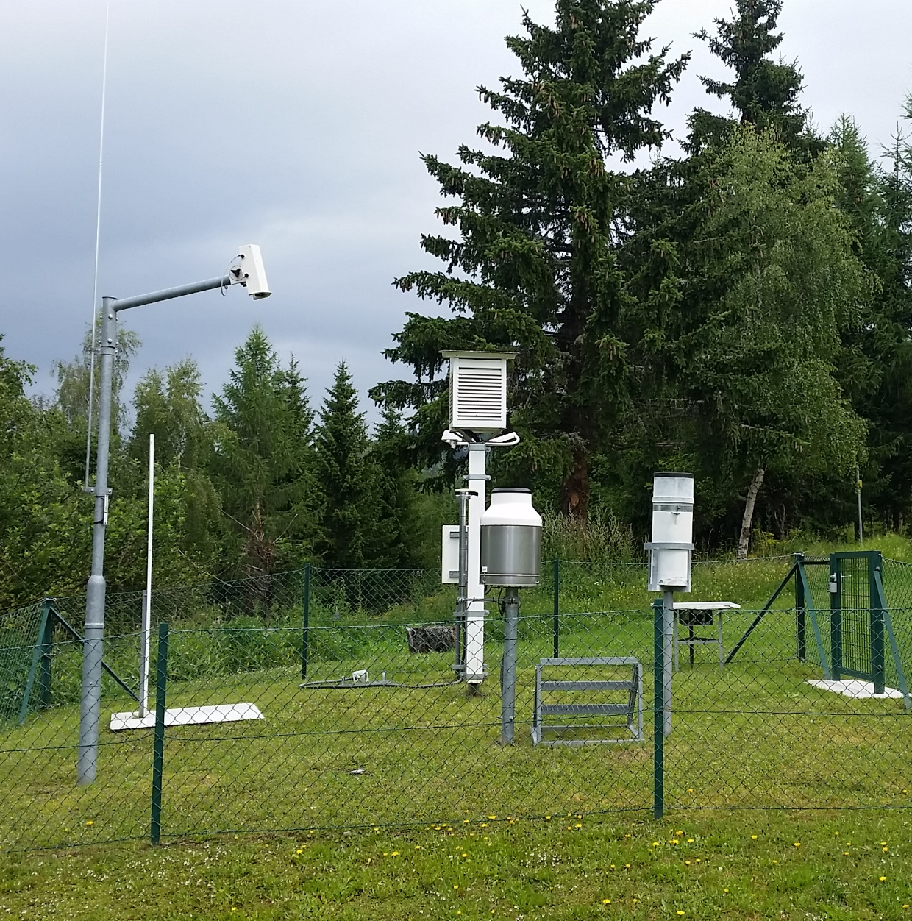
1. Manual climatological observation network
Manual observations:
Current and past weather conditions (thunderstorms, fog, snowfall, …)
Ground state (frozen, …)
Visibility
Clouds (cloud cover)
Precipitation (rain & snow)
Temperature, ….
Observation times:
until 1971: 7, 14, 21 LMT
1971 – 2003: 7, 14, 19 LMT
since 2003: 7, 14, 19 CET

Slide 5
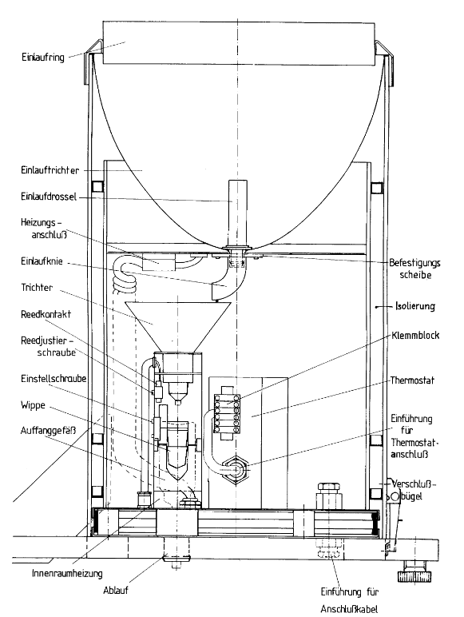
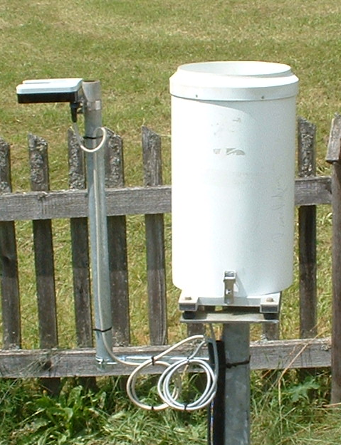

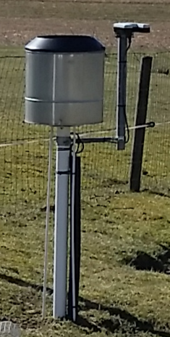
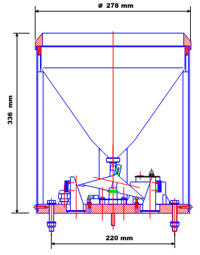
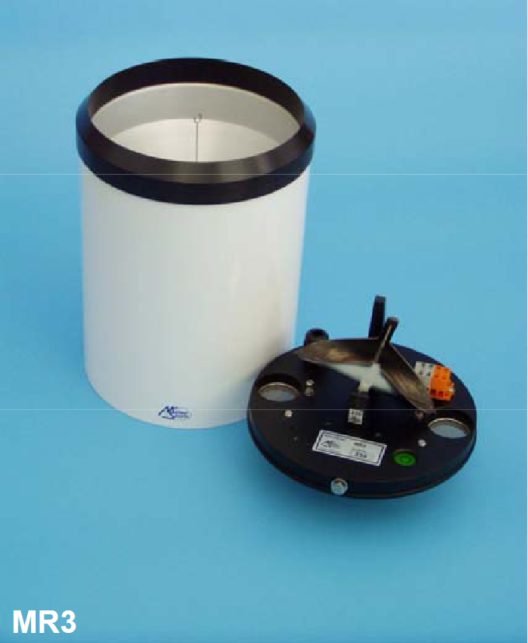
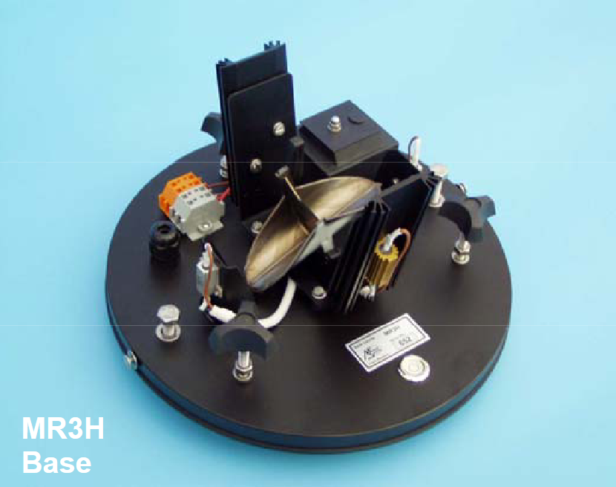
1. Precipitation gauges
All gauges are heated, and operated without windshield.
Resolution: 0.1 mm
Weighing bucket precipitation gauges: MPS TRWS
2 gauge types
405 503
Tipping bucket gauges
Paar AP23
orifice size: 500 cm²
Meteoservis MR3H-F
orifice size: 500 cm²
orifice size: 400 cm²
orifice size: 500 cm²
Precipitation monitor (Thies Clima):
Start and end of precipitation events
© GeoSphere Austria

Slide 6
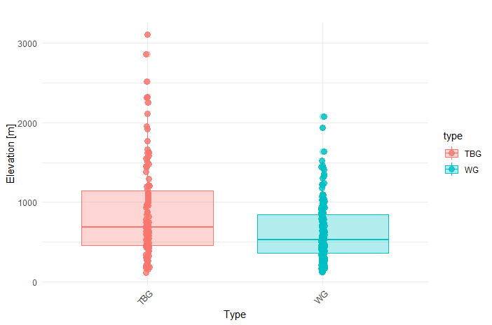
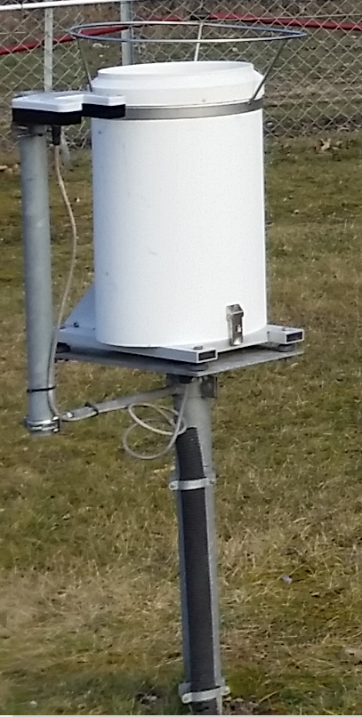
1. Vertical distribution – tipping bucket gauges (TBG) ; weighing gauges (WG)
TBG:
Paar AP23
Meteoservis
MR3H-F(C)
WG:
MPS TRWS 405, 504

Slide 7
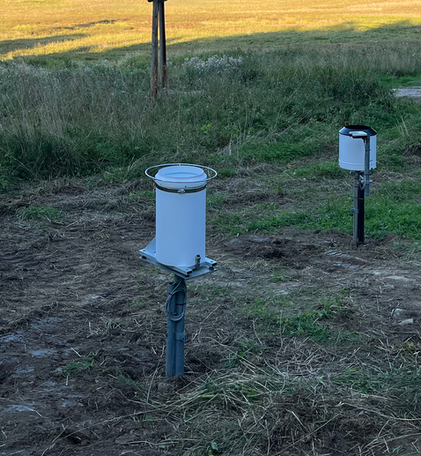
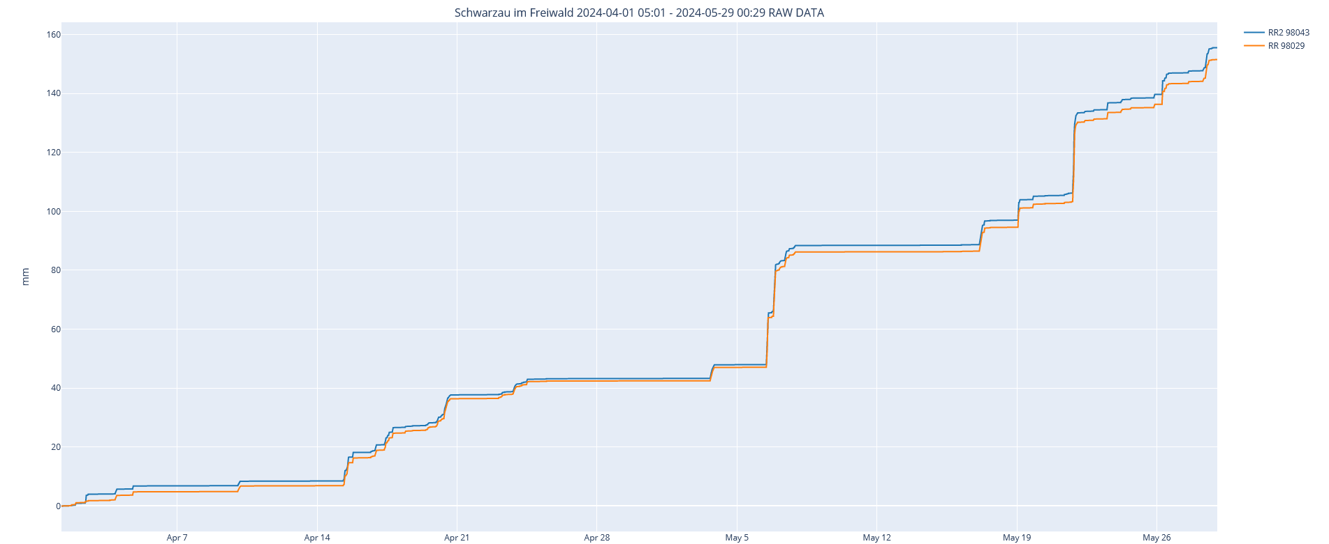


1. Comparison of collocated TBG vs. WG
RR: WG MPS TRWS
500cm²
RR2: TBG AP23
500cm²
$$\sum_{April}^{May}{RR}=151.5 mm$$
$$\sum_{April}^{May}{{RR}_{2}}=155.5 mm$$

Slide 8
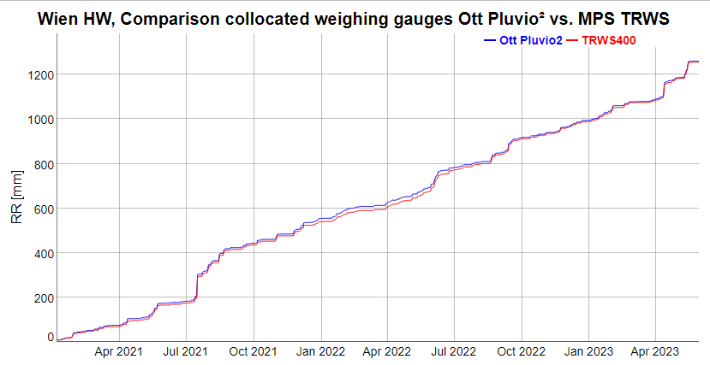
1. Comparison to Hydrological Office standard gauge TAWES-standard = MPS TRWS

Slide 9

2. QC at GeoSphere Austria
Tasks within the scope of the Data Quality Management:
Data Quality Analysis
Quality control
Quality assurance
Development and maintenance of test procedures
Storage of raw and quality-checked data
Documentation of all data modifications (metadata)
Climate-impact Research
Climate and Environment Services
Climate Services
Environmental Meteorology
QC-tool: AQUAS –Austria Quality System
QualiMet*
2006
2014
AQUAS dev. project
AQUAS
2017
*) Spengler R., 2002. The new Quality Control- and Monitoring System of the Deutscher Wetterdienst. Proceedings of the WMO Technical Conference on Meteorological and Environmental Instruments and Methods of Observation, Bratislava, 2002.

Slide 10
2. Data Quality Management at GeoSphere Austria
Comprehensive system for quality control and quality assurance
Data acquisition
Real-time processing of raw data
AQUAS
Automated basic & extended QC of processed data in near real-time*
Data storage & supply
Storage of raw and processed data
basic QC (consistency tests, gross errors check, range check (plausibility), climatological limits, etc.)
Calculation of derived quantities (hourly, daily data,…)
Correction procedures
Data distribution to the users
Meta data
*) WMO guidelines on quality control (WMO-No 100)

Slide 11
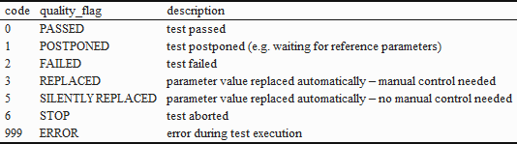
2. AQUAS – simplified system structure
TAWES + third-party networks
Data
raw data base
AQUAS kernel
Data management (time formatting/
combination of different data sets, …
disposer
Basic & extended QC tests:
Consistency tests (internal, temporal, spatial)
Cross-check using aux. data sources (satellite, radar, …)
Statistical tests
T approaching climatological extreme value;
Rapid change and spike test
Temporal variability over a period of time
…
Working database
inspector
AQUAS-Editor (GUI)
producer/hive
derived quantities
data aggregation
publisher
data bases (QC)
end-users

Slide 12
2. AQUAS – advantages and challenges
AQUAS characteristics
AQUAS-QC – challenges
arbitrary time intervals
parameter-wise processing
arbitrary parameters and check-routines
automated QC in real-time
Challenging operational QC primarly due to the non-uniform instrumentation across the network:
tipping bucket and weighing rain gauges
different time resolution (1-, 10-, 15-min) at reference parameters (radar, PWS, hydrological precipitation network)
Configuration effort!

Slide 13
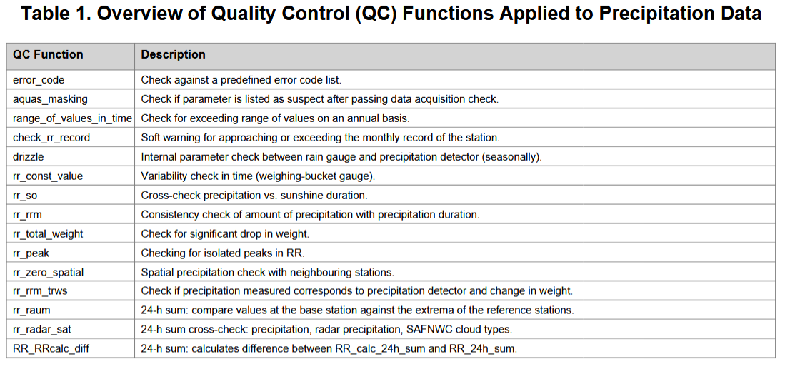
3. QC of precipitation data in AQUAS
Completeness & gross error
Climatological limits
Persistence check
Internal consistency
Temporal consistency
Spatial consistency

Slide 14
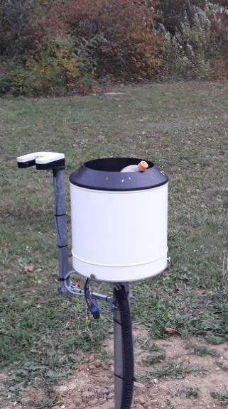
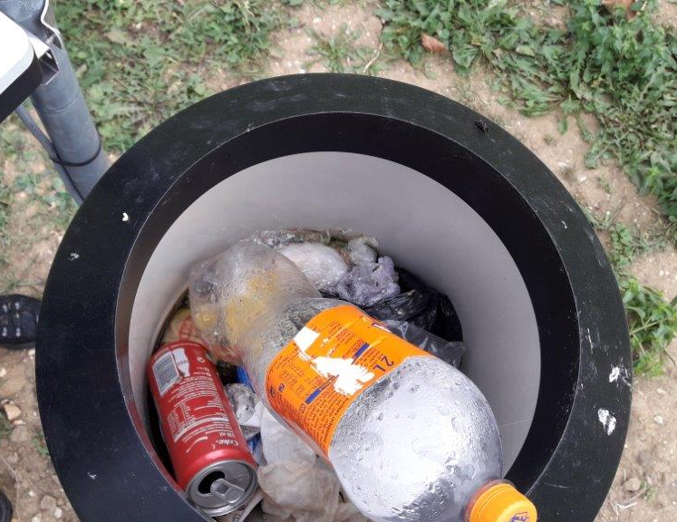
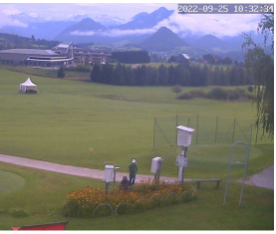
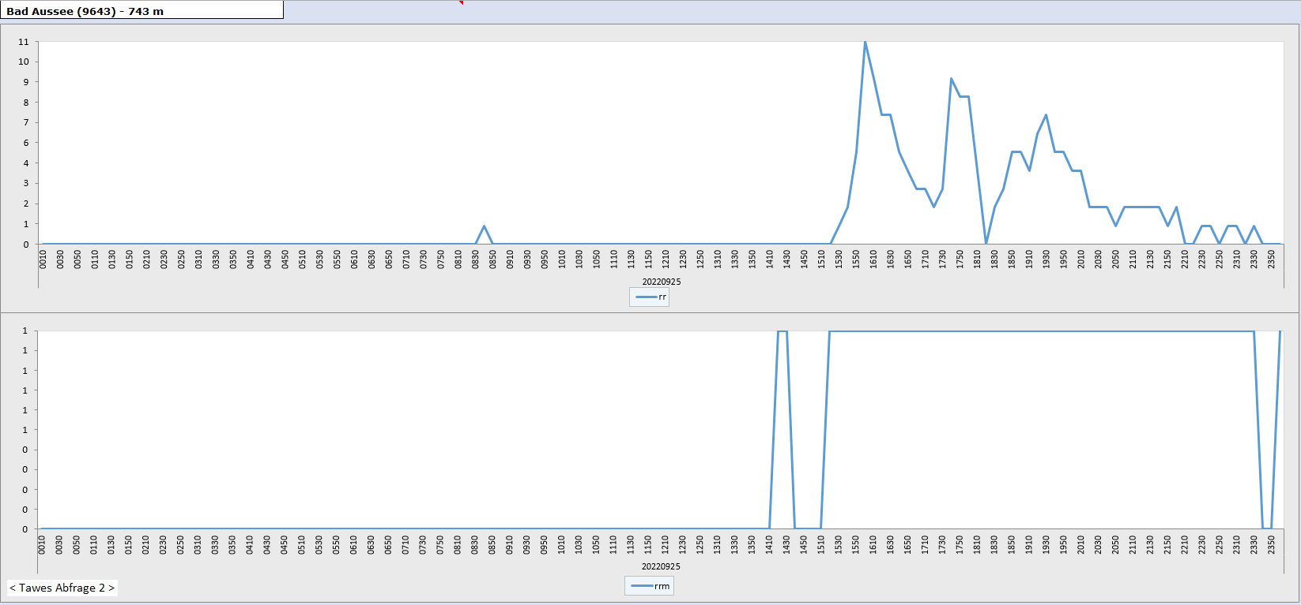
3. Error sources – some examples
Misuse of a precipitation gauge as a rubbish bin –
misinterpretation of the definition of a accumulation gauge.
Manipulation on the gauge
by external parties.

Slide 15
3. Weighing precipitation gauges
Most common problems operating weighing precipitation gauges:
Spurious precipitation
virtual changes of the bucket weight caused by rapid temperature changes or wind induced vibrations of the gauge
2. Missing precipitation
for no apparent reason – a firmware update can be helpful, sometimes
@1: This type of error can be detected by a cross-check with other parameters measured at the same station or by a spatial check; correction consists of removing incorrect measurement signals.
@2: compared to 1.: detecting this type of errors is a more complex issue, and correction is even more challenging and not always possible (imputation techniques required).

Slide 16
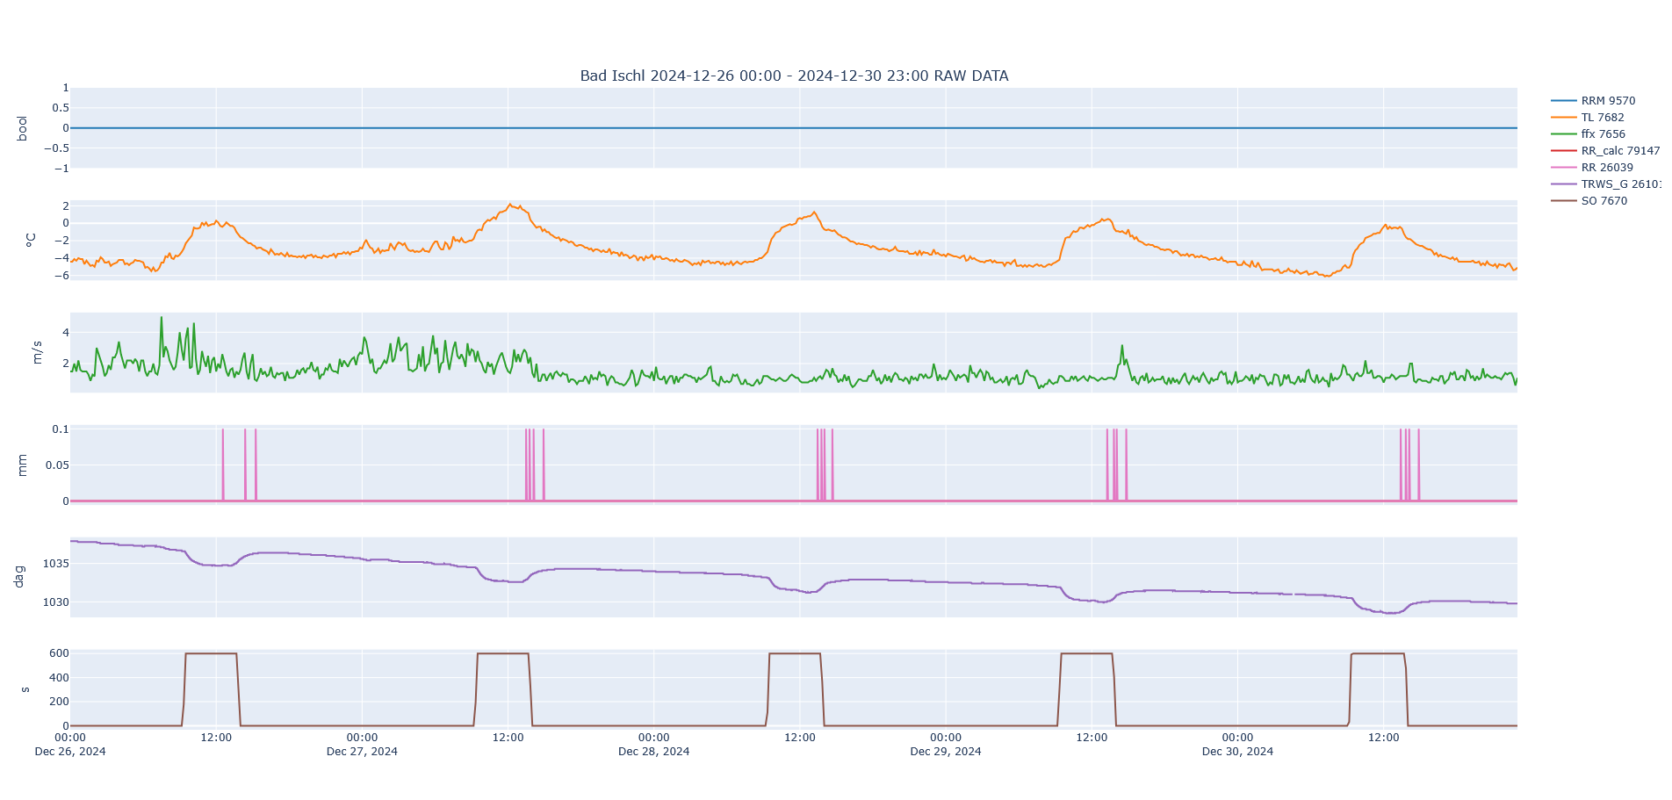
3. Spurious precipitation (periodic noise)
precipitation detector
error
bucket weight
sunshine duration

Slide 17
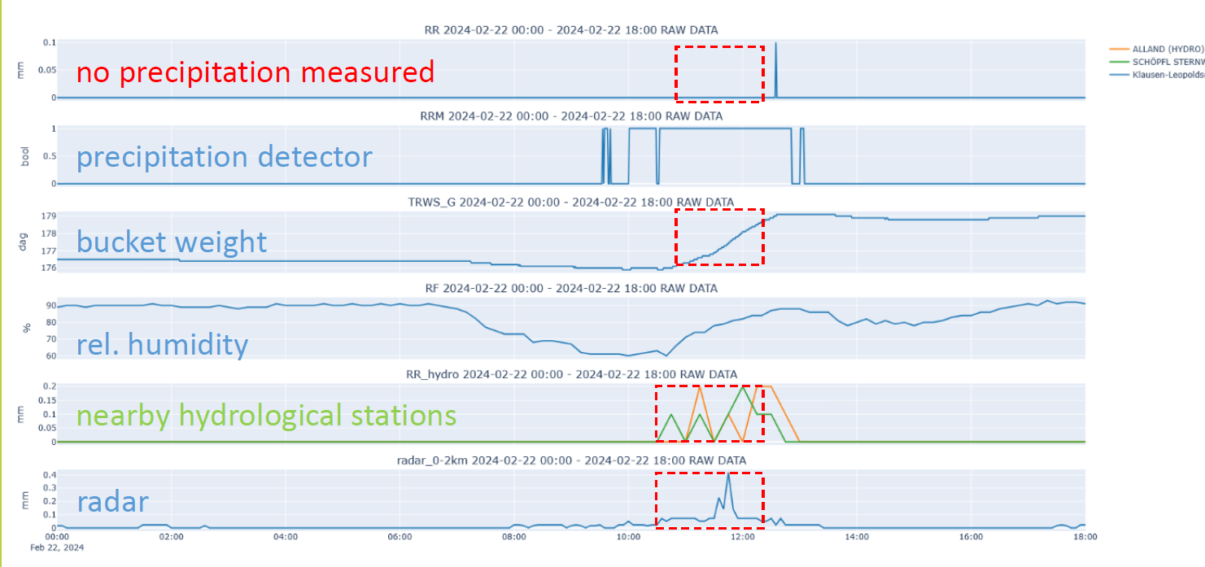
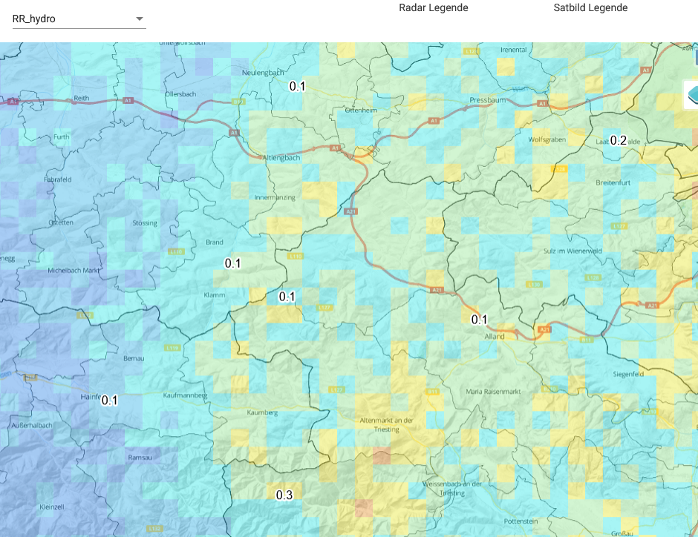
3. Missing recordings

Slide 18
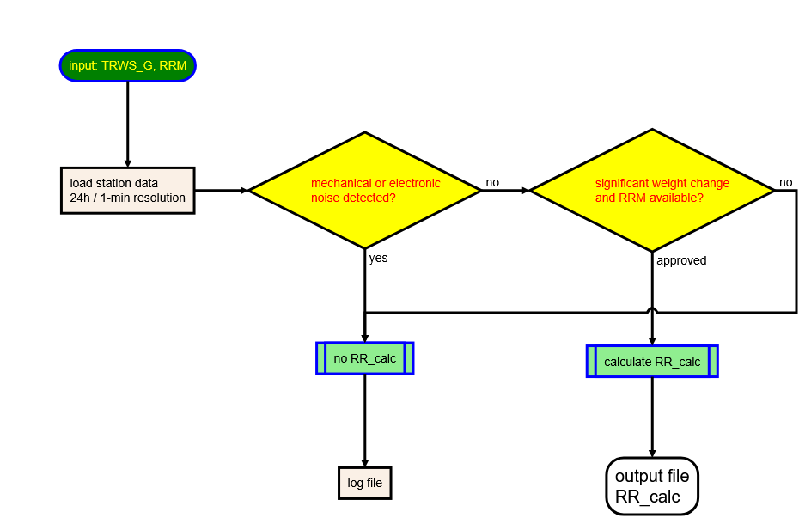
4. RR_calc - algorithm for estimating missing weighing gauge precipitation data
Problem:
Missing weighing gauge precipitation measurements during normal operation (no outage), when bucket weight recording is available.
Since the algorithm used to generate data by the gauge software is usually unknown (black-box), there is no way to recover the lost data.
Problem-solving approach: An automated algorithm was developed to estimate missing data.
Simplified flow-chart of the RR_calc algorithm.
Purpose: Derives rainfall data from a sensor signal (gauge bucket weight) using:
physical scaling (orifice size) of the consecutive changes in weight,
plausibility filtering (RRM), and
reset logic (filtering negative weight increments).
Core Idea: Like a digital rain gauge algorithm — turning incremental weight increases into rainfall intensity, filtering implausible signals, and preventing drift.

Slide 19

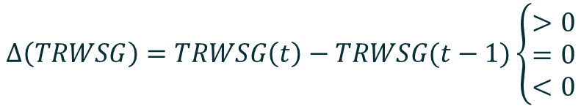



4. RR_calc – outline of the workflow
Raw Sensor Data (TRWSG) + Plausibility Data (RRM)
Filtering of decanting and recharging of the bucket
$$∆\left(TRWSG\right)=TRWSG\left(t\right)−TRWSG(t−1)\left\{\begin{aligned}>0 \\ =0 \\ <0\end{aligned}\right.$$
Calculate lagged differences Δ(TRWSG) and accumulate scaled* differences sdiff
$$sdiff= ∆\left(TRWSG\right)∗scale_factor$$
*scale factor depends on gauge type (orifice size)
Internal accumulation, sdiff should not be negative
Apply plausibility filter (RRM)
$$\sum_{window}{RRM\left[(t−window):t\right]≥rrm_threshold}$$
Rainfall reference from independent instrument – weight increase without RRM is ignored
„Quantize“ rainfall increments (RR_i)
Reset when inactive too long
$${RR}_{i}=0.1∗int\left({sdiff}/{0.1}\right)$$
ensures rainfall steps of 0.1 mm
$$if no_change_counter>= reset_steps→sdiff=0$$
automatically resets after long dry periods
Output: RR_calc (new rainfall rate)
$$RR_{calc}={RR}_{i}$$

Slide 20
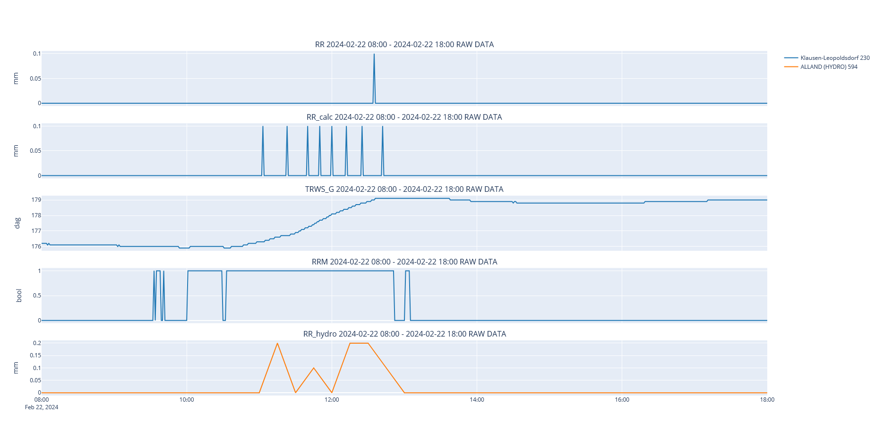
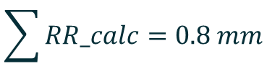
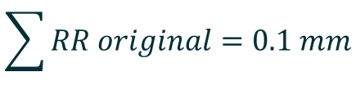
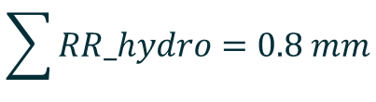
4. RR_calc example
$$\sum{RR original}=0.1 mm$$
$$\sum{RR_calc}=0.8 mm$$
$$\sum{RR_hydro}=0.8 mm$$

Slide 21

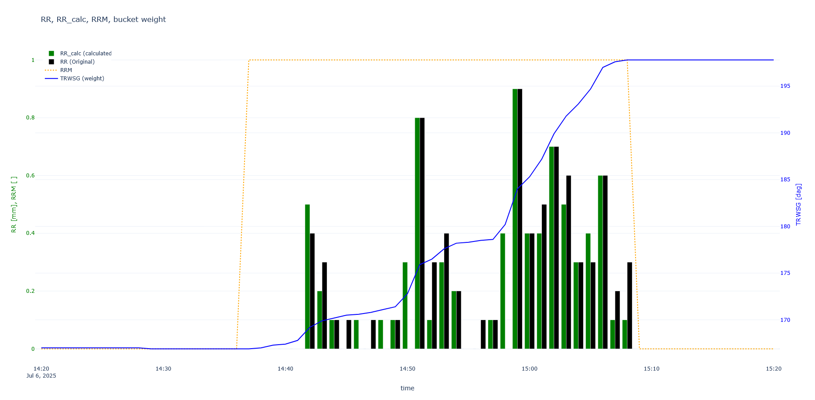
4. Example for 1h-accumulation …

Slide 22

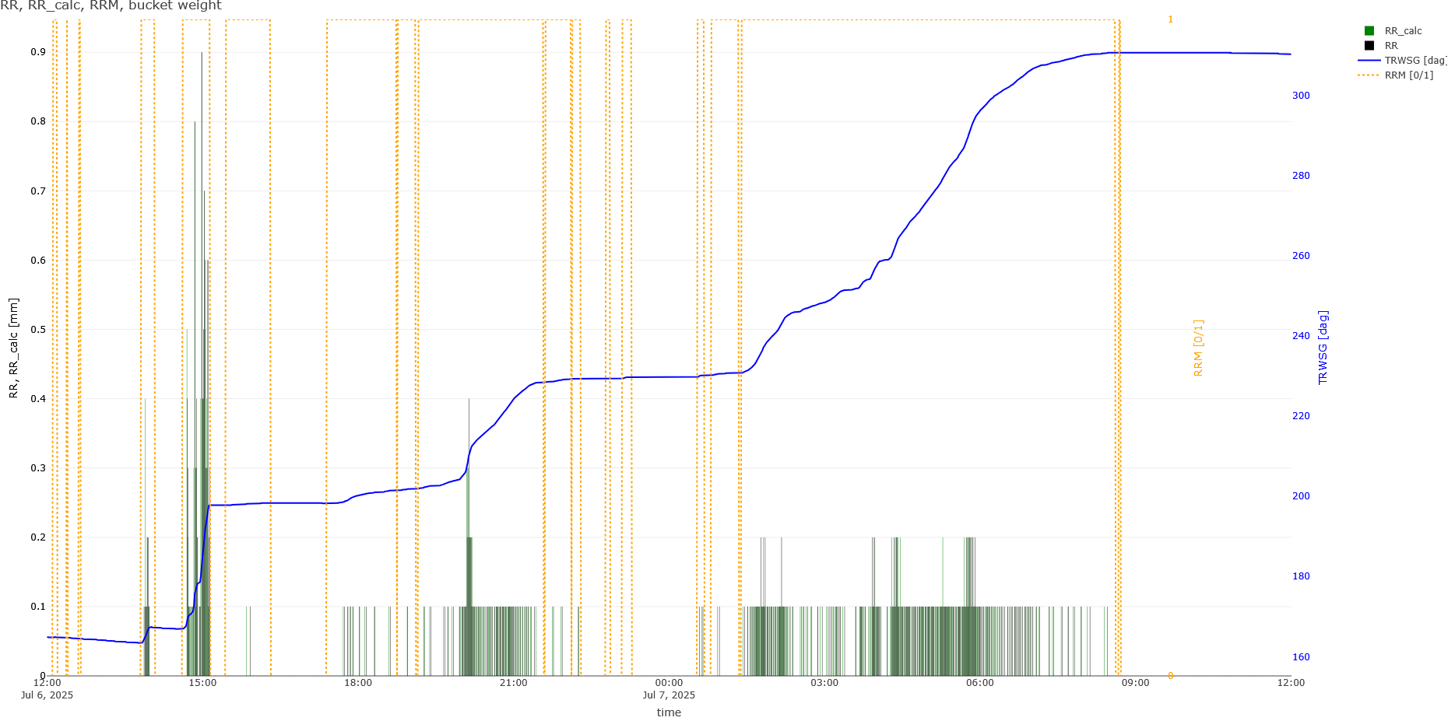
… and for 24h-accumulation

Slide 23
Summary
Spurious and missing records are the most significant problems in monitoring precipitation data and subsequently alter the climate information derived from the data.
We propose a method (RR_calc) for deriving precipitation data from the raw gauge weight records using additional information from an independent precipitation sensor.
RR_calc
The RR_calc method is a heuristic approach developed to mimic the weighing gauge software, currently it is used to support experts in the manual verification of precipitation data. The method relies on the existence of an independent source of precipitation information.

Slide 24
Thank you!
Data Quality and Digitization
Niko Filipović
niko.filipovic@geosphere.at

