Slide 1



Homogenized and gridded
daily mean temperature data series from 1851
Olivér Szentes^{1,2}
¹Climate Research Department, HungaroMet Hungarian Meteorological Service
²ELTE Faculty of Science, Doctoral School of Earth Sciences
Data Management Workshop
Oslo, 2025

Slide 2
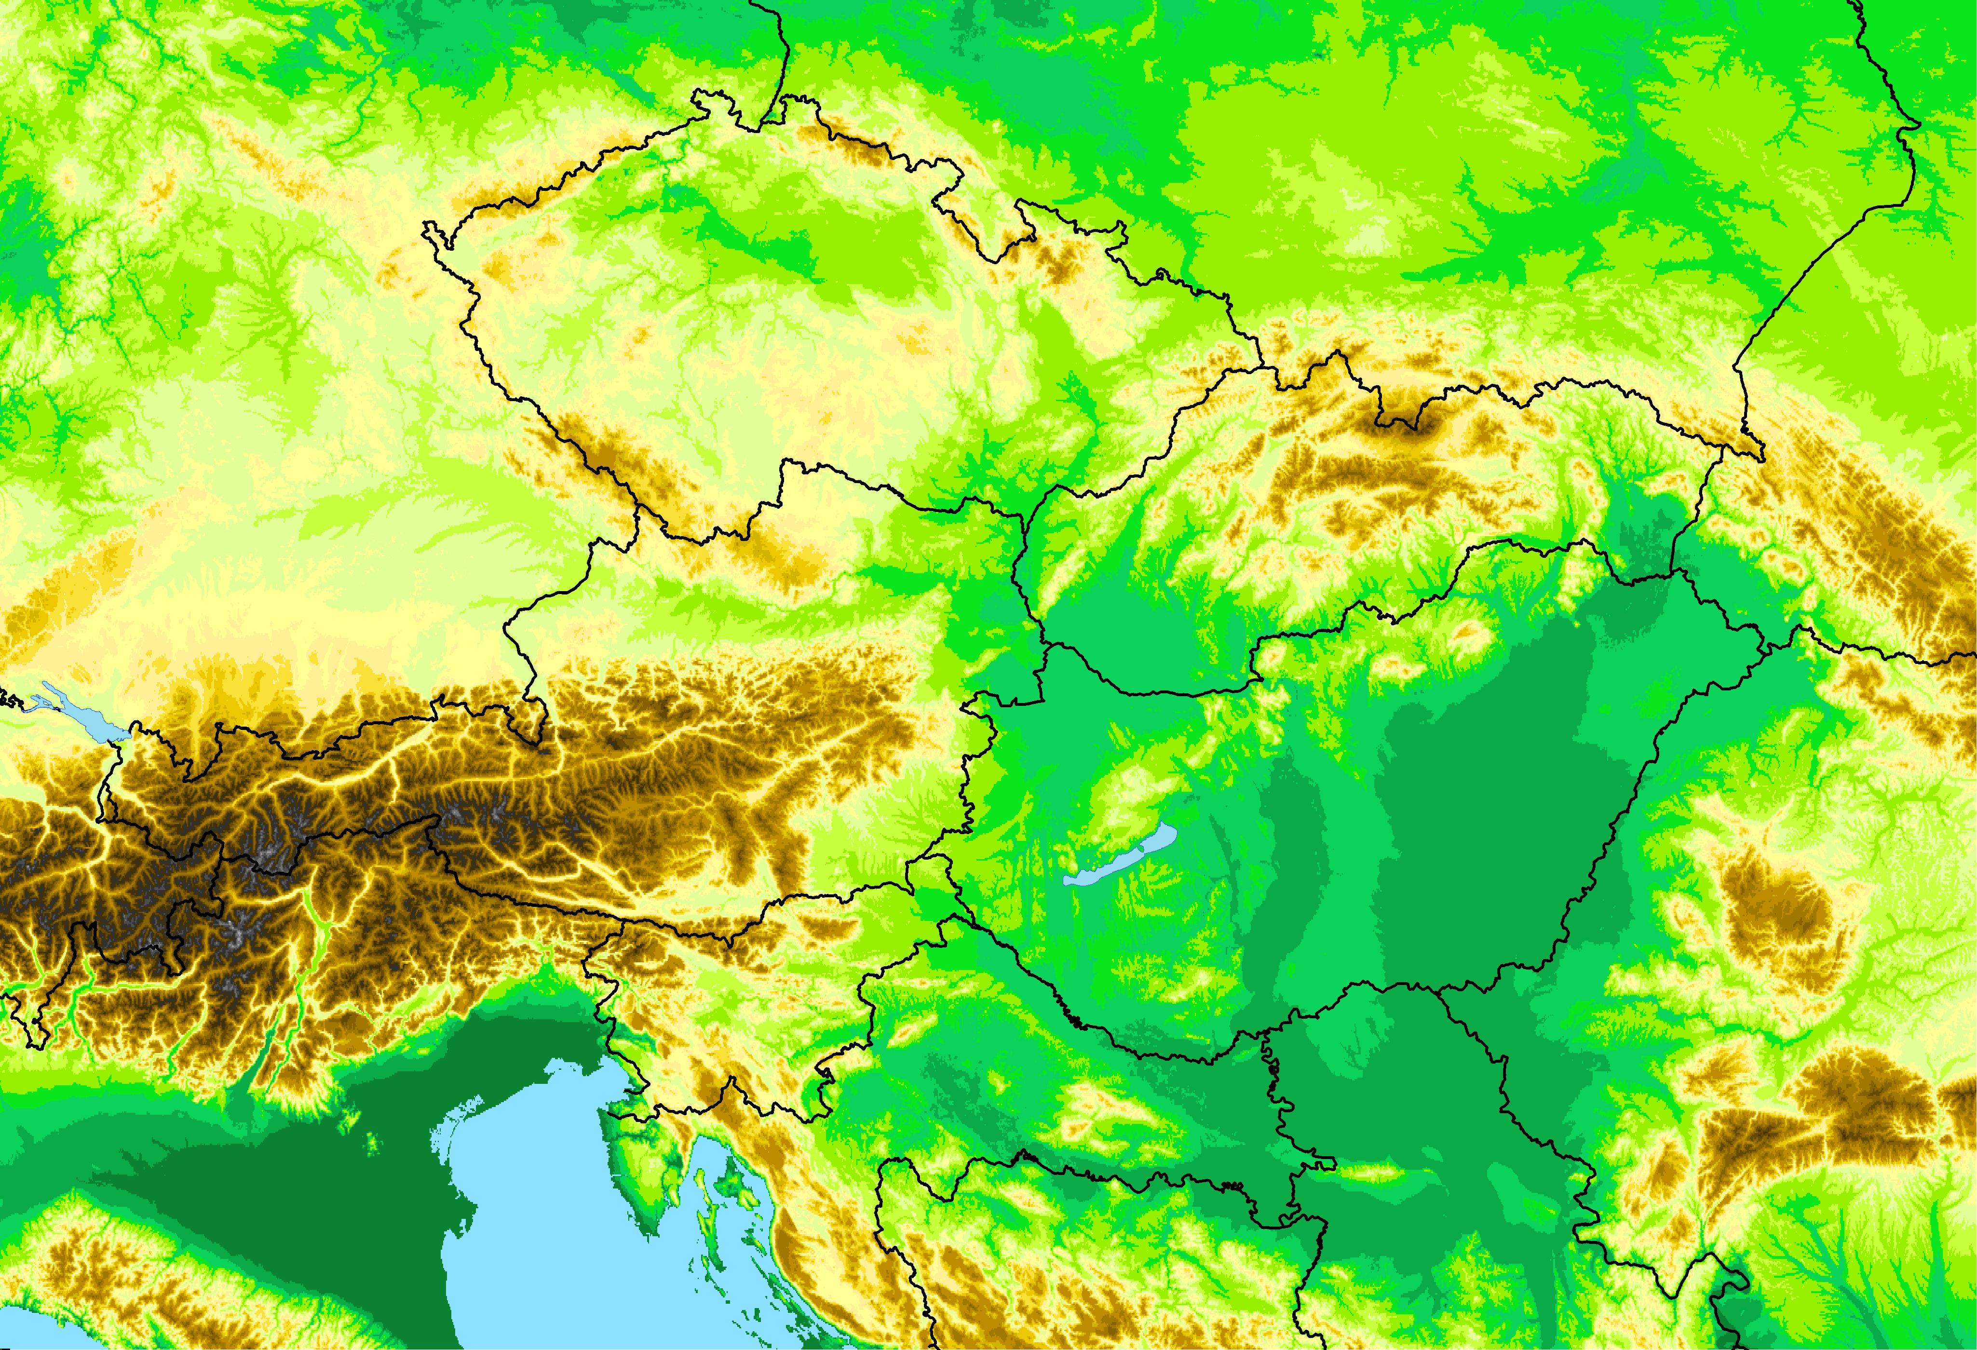

Introduction
The aim: to create daily, homogeneous, gridded mean temperature database from 1851
Using several Central European stations for homogenization
There are longer data series from this area, which are still relevant for the creation of the long-term temperature climate data base for Hungary.
An idea arose:
to collect as much data as possible for both parts, from which the most data are available since the 1850s
to create a daily database for both parts from 1851 using the same method
The eastern part: Hungary
The western part: Austria
ATCLIM
HUCLIM

Slide 3
The creation of representative climatological database with MASH and MISH software:
http://www.met.hu/en/omsz/rendezvenyek/homogenization_and_interpolation/software/
MASHv3.03
(Multiple Analysis of Series for Homogenization; Szentimrey, T.)
For temporal representativity (homogenization, quality control and missing value completion of station data series)
MISHv1.03
(Meteorological Interpolation based on Surface Homogenized Data Basis; Szentimrey, T. and Bihari, Z.)
For spatial representativity (interpolation of homogenized data series)
References:
Szentimrey, T., Bihari, Z., 2014: Manual of interpolation software MISHv1.03, Hungarian Meteorological Service, p. 60.
Szentimrey, T. 2017: Manual of homogenization software MASHv3.03, Hungarian Meteorological Service, p.71.

Slide 4
homoganization software: MAsh
The homogenization of monthly series:
relative homogeneity test procedure
a step-by-step iteration procedure
additive (e.g. temperature) or multiplicative (e.g. precipitation) model
quality control and missing data completion
homogenization of monthly, seasonal and annual series
metadata (probable dates of break points) can be used automatically
verification files generated automatically
The homogenization of daily series:
based on the detected monthly inhomogeneities
quality control and the completion of missing data in daily data

Slide 5
Interpolation software: Mishv1.03
The modeling subsystem for statistical (local and stochastic) climate parameters:
based on long homogenized data series and supplementary deterministic model variables (height, topography, distance from the sea etc.)
additive (e.g. temperature) or multiplicative (e.g. precipitation) model
the modeling procedure must be executed only once before the interpolation applications
high resolution grid (e.g. 0.5’×0.5’)
The interpolation subsystem:
using the modeled parameters at the interpolation of the meteorological elements to any point of the grid
use of background information (e.g. satellite, radar, forecast data)
data series completion (missing value interpolation for daily or monthly station data)

Slide 6
Creation of the ATCLIM database
I.: Collecting of the data series

Slide 7
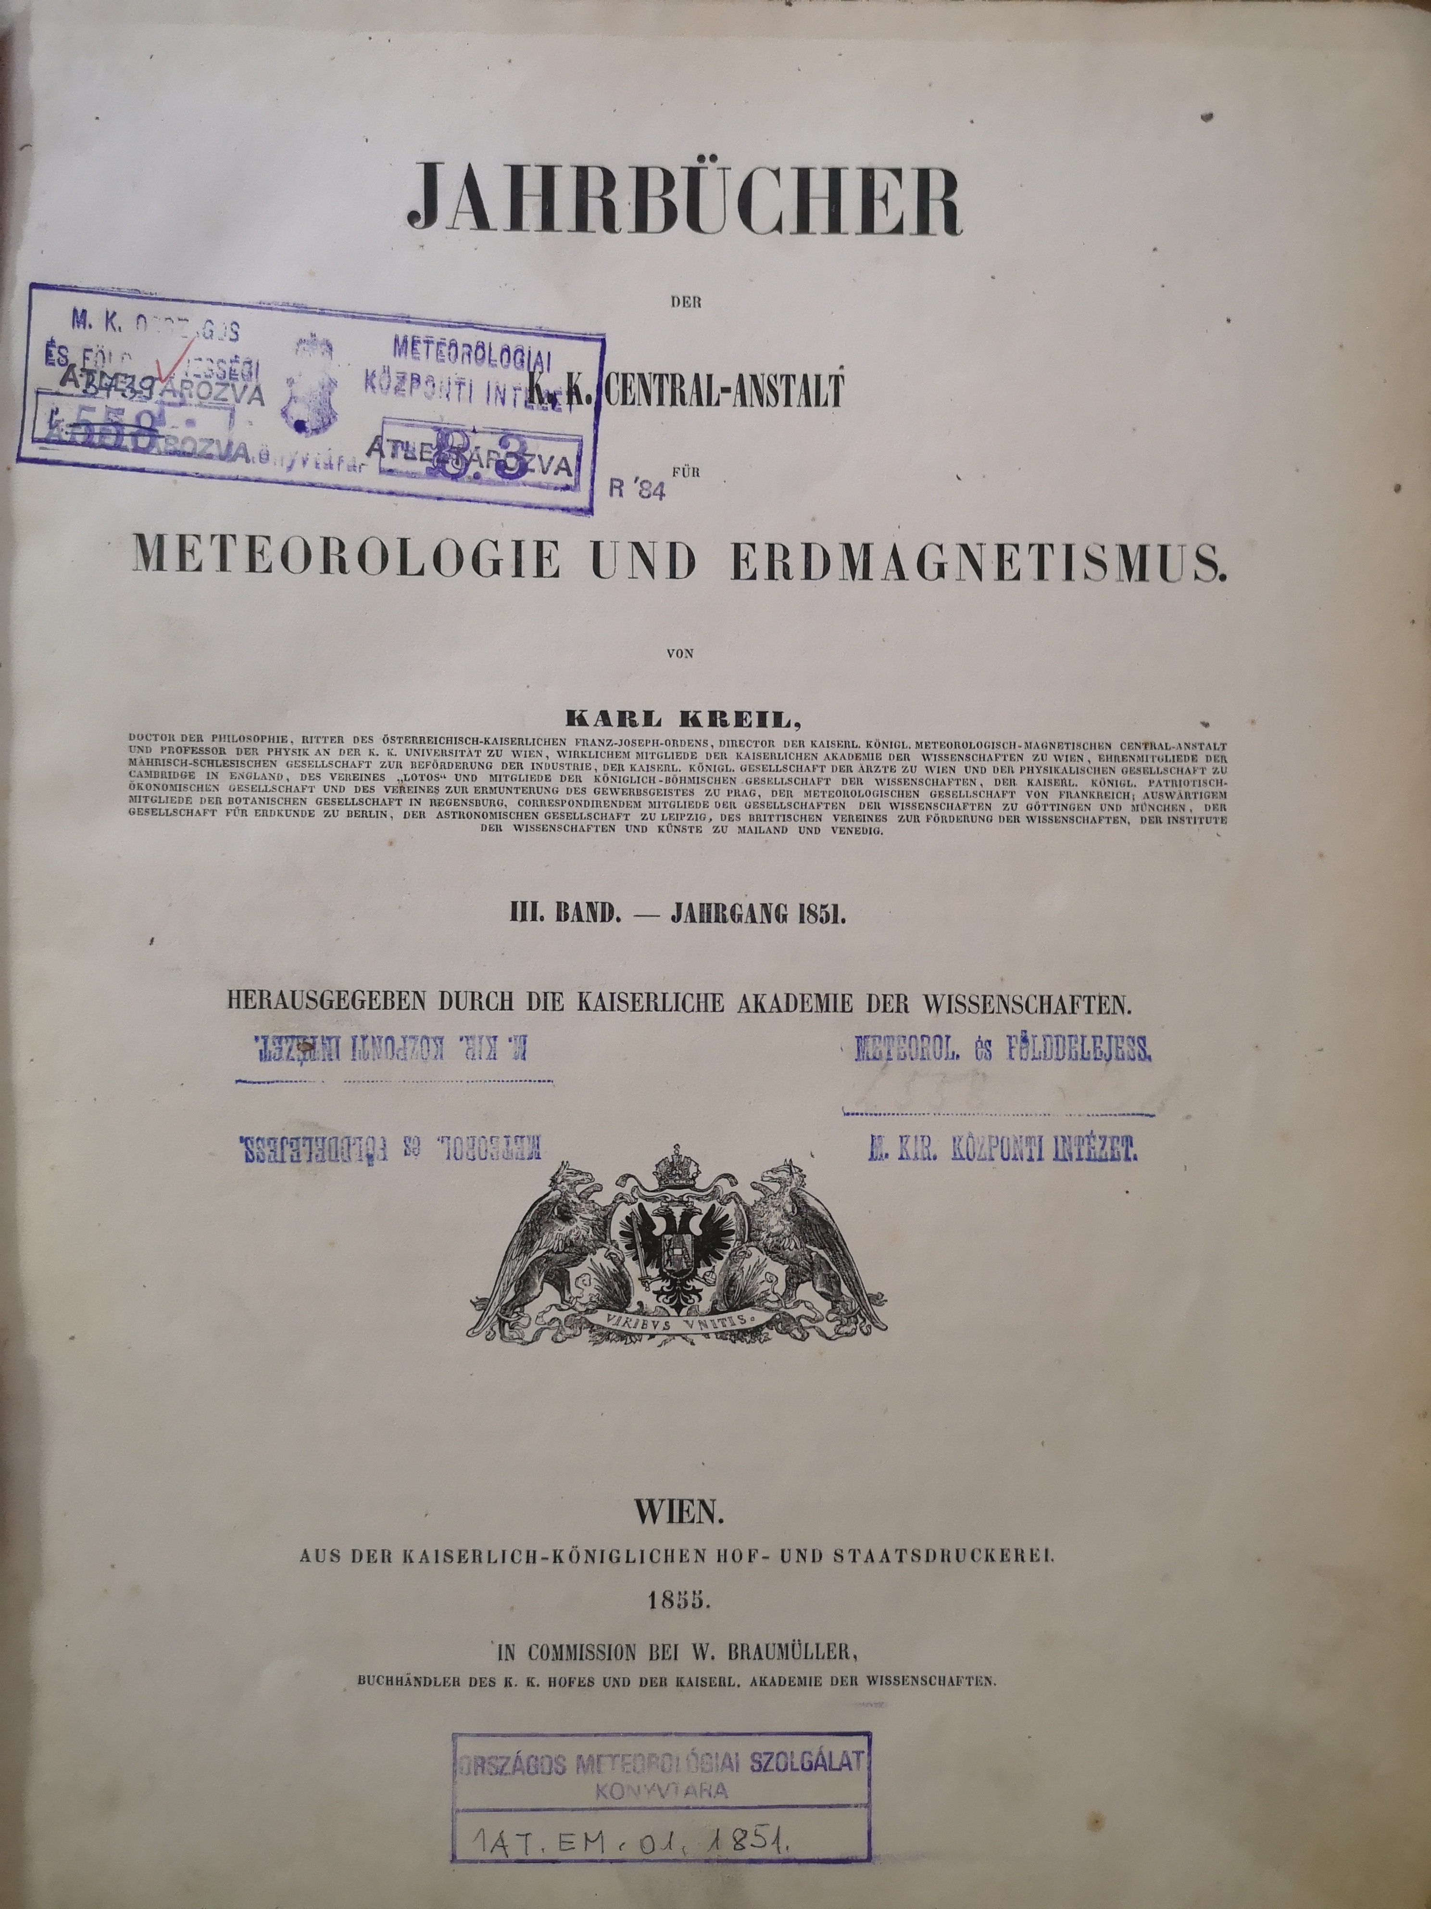
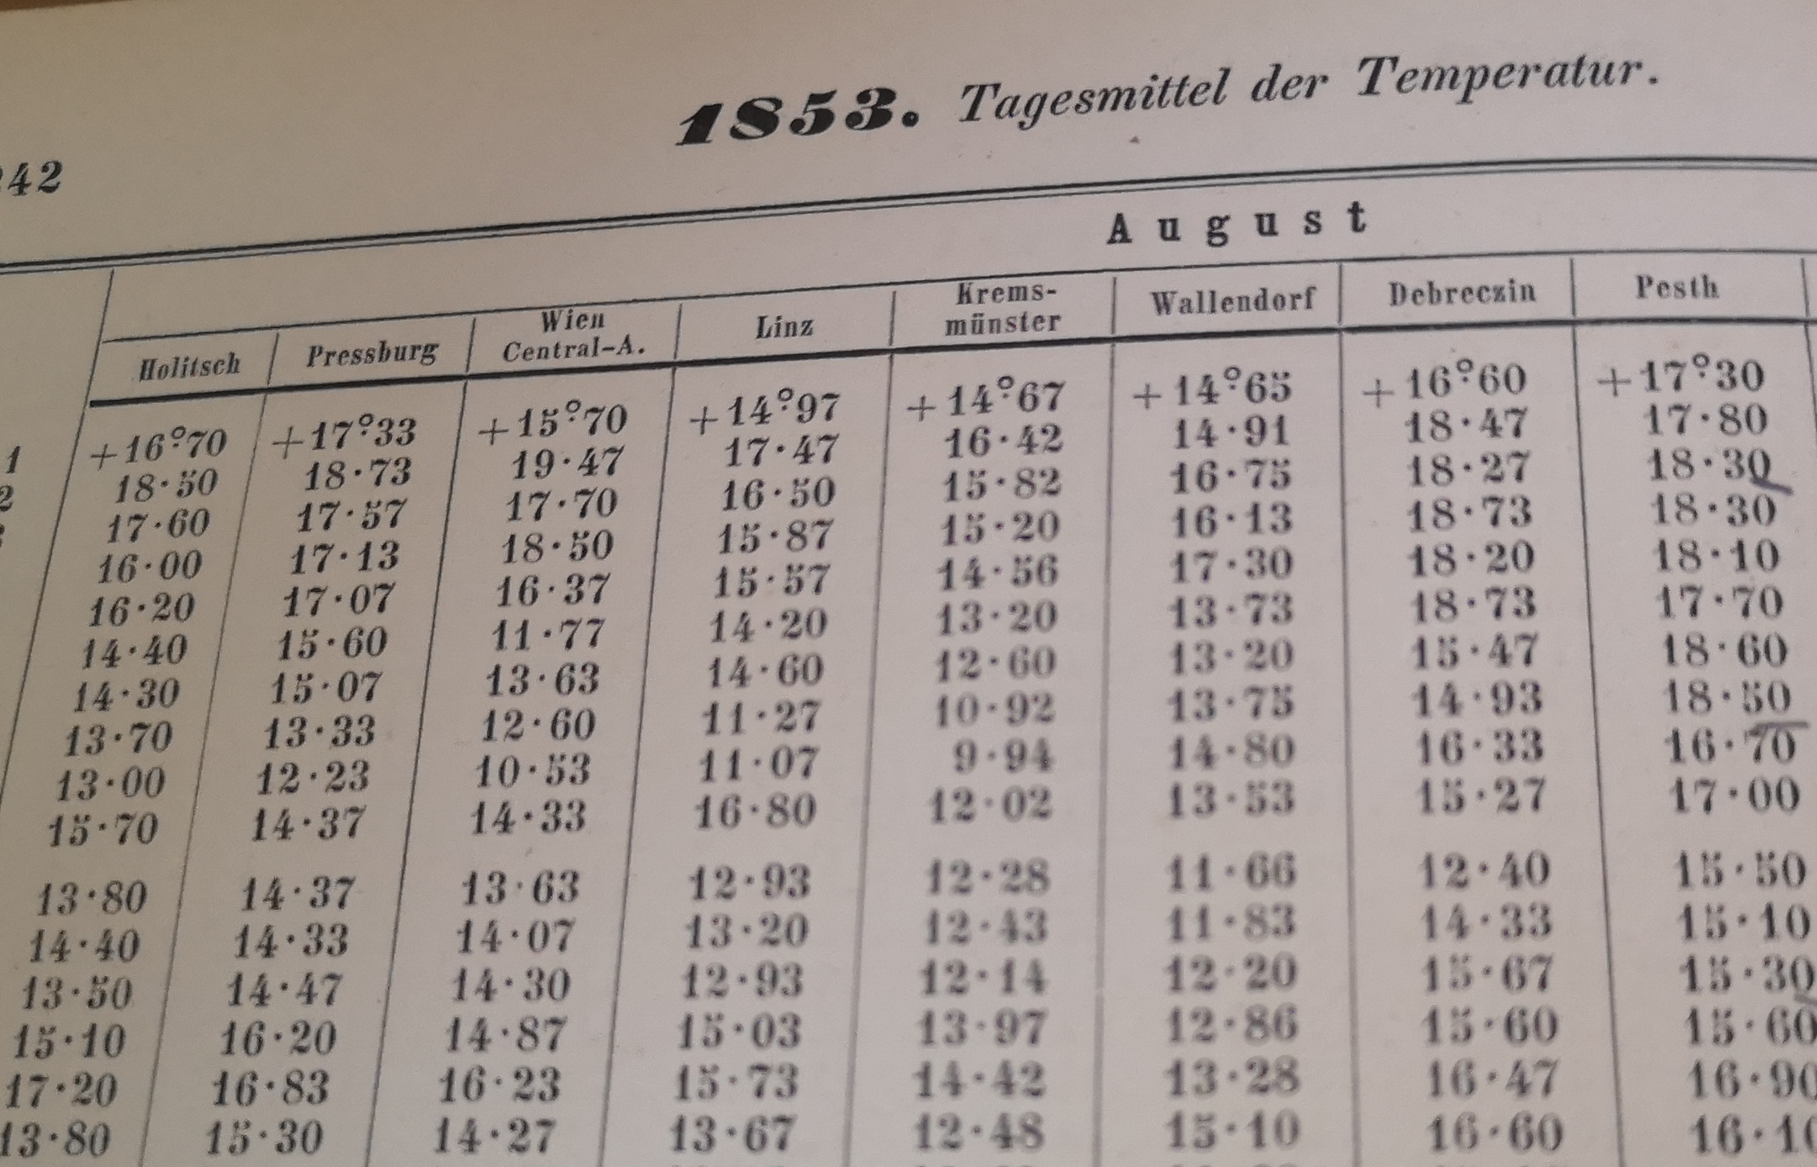
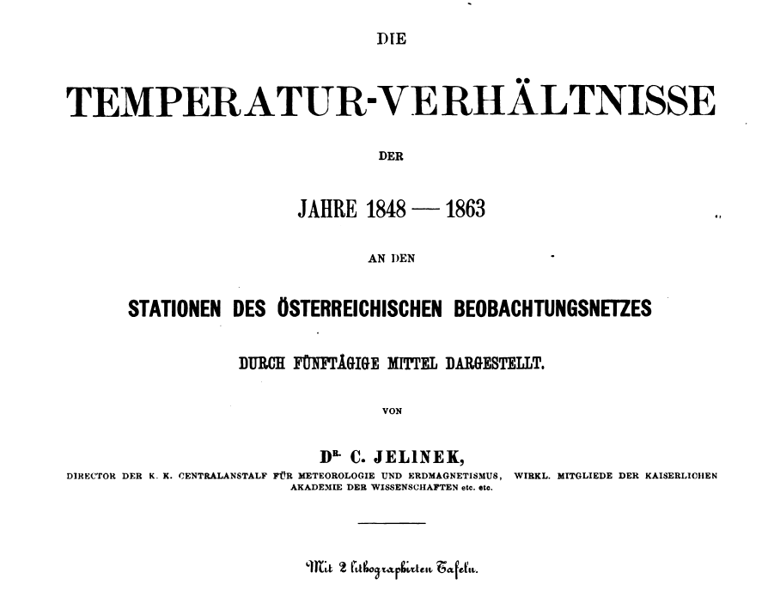
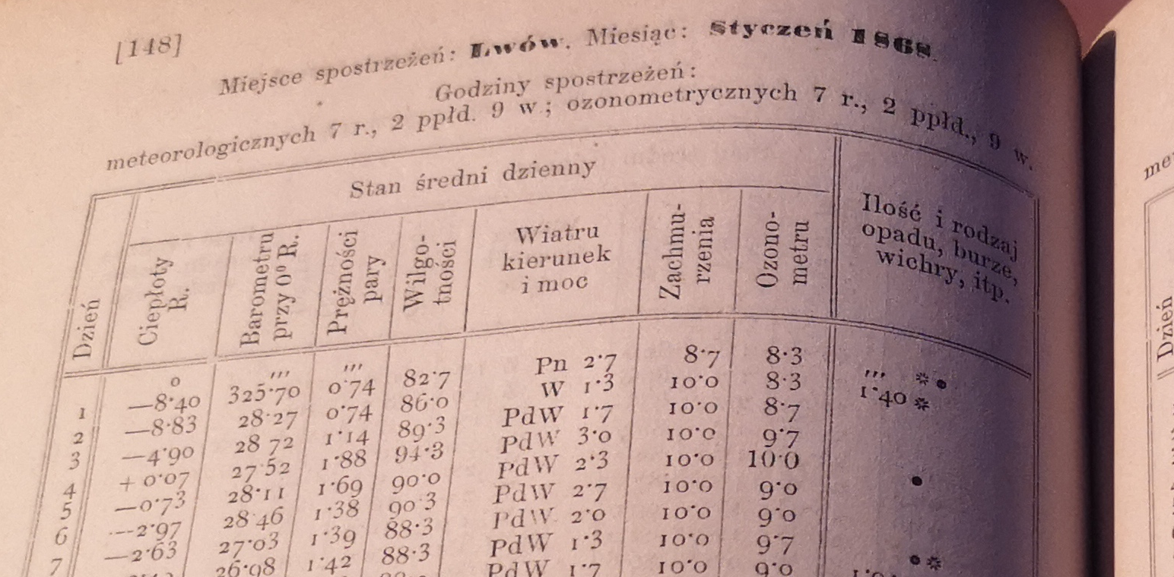
I.: Collecting of the data series
Daily station data series from GeoSphere Austria Data Hub: https://data.hub.geosphere.at
The majority of data series were digitized/available from the mid-20th century (1936)
A lot of monthly (also daily from some stations) temperature data are available in books (e.g. yearbooks), which contain mean temperature data for all stations in Austria.
Recently, all the monthly mean temperature data have been collected from 1851 to 1950, which have not yet been available in Data Hub.
Three yearbooks were missing from our library; thank you to Geosphere Austria for the scanned copies.
Calculation of mean temperature:
Before 1971: (T07+T14+2×T21)/4
From 1971: (T07+T19+Tmin+Tmax)/4

Slide 8
Creation of the ATCLIM database
I.: Collecting of the data series
II.: Station systems for homogenization (monthly and daily)

Slide 9
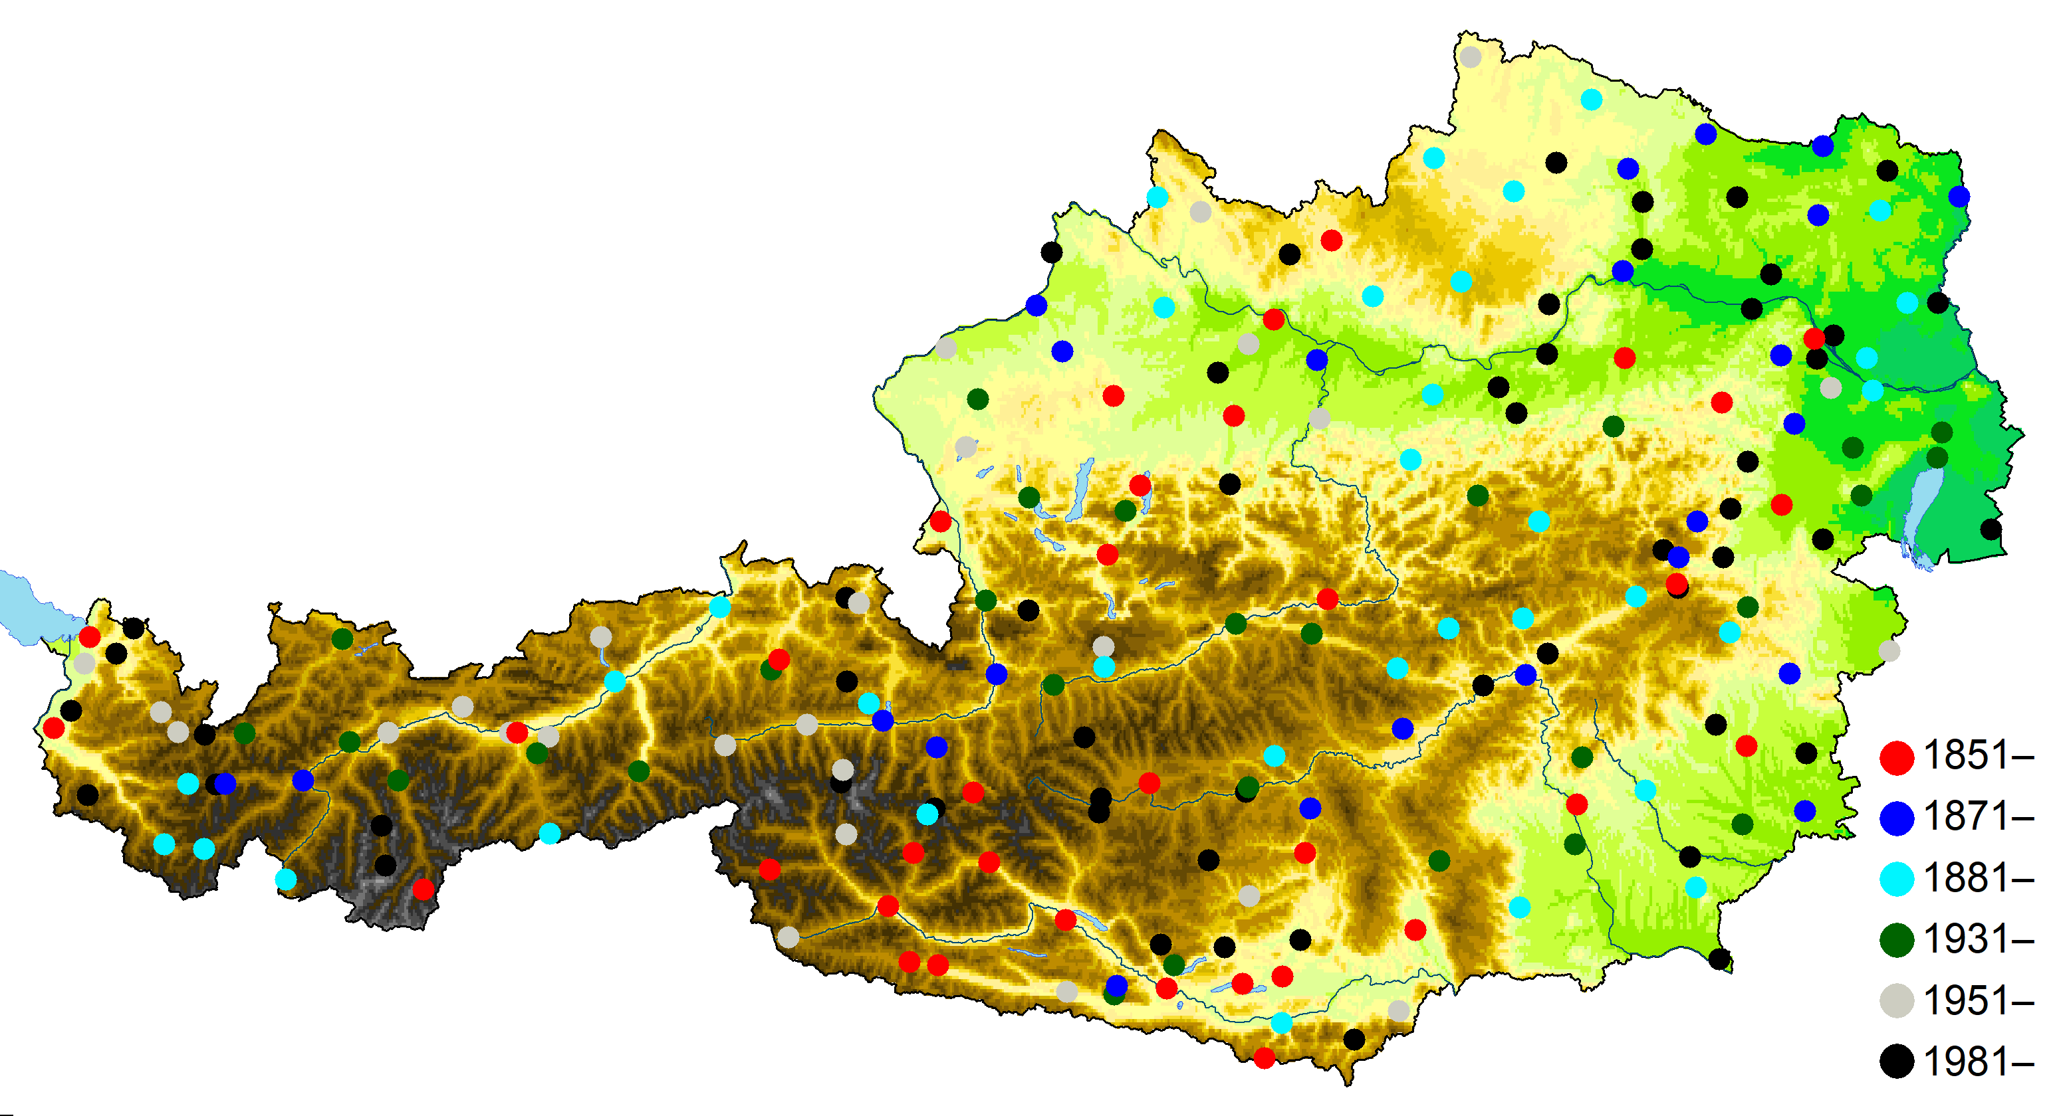

II.: Station systems for homogenization
Homogenization of monthly series in 6 steps (MASHm systems)
Homogenization of daily series in 5 steps (MASHd systems)
The daily homogenization based on MASHm results
From 1951, monthly (MASHm) and daily (MASHd) station systems are the same
Monthly
Daily
1851-2024: 35 stations
1871-2024: 59 stations
1881-2024: 93 stations
1931-2024: 121 stations
1951-2024: 147 stations
1981-2024: 200 stations
1851-2024: 10 stations
1895-2024: 24 stations
1936-2024: 81 stations
1951-2024: 147 stations
1981-2024: 200 stations

Slide 10
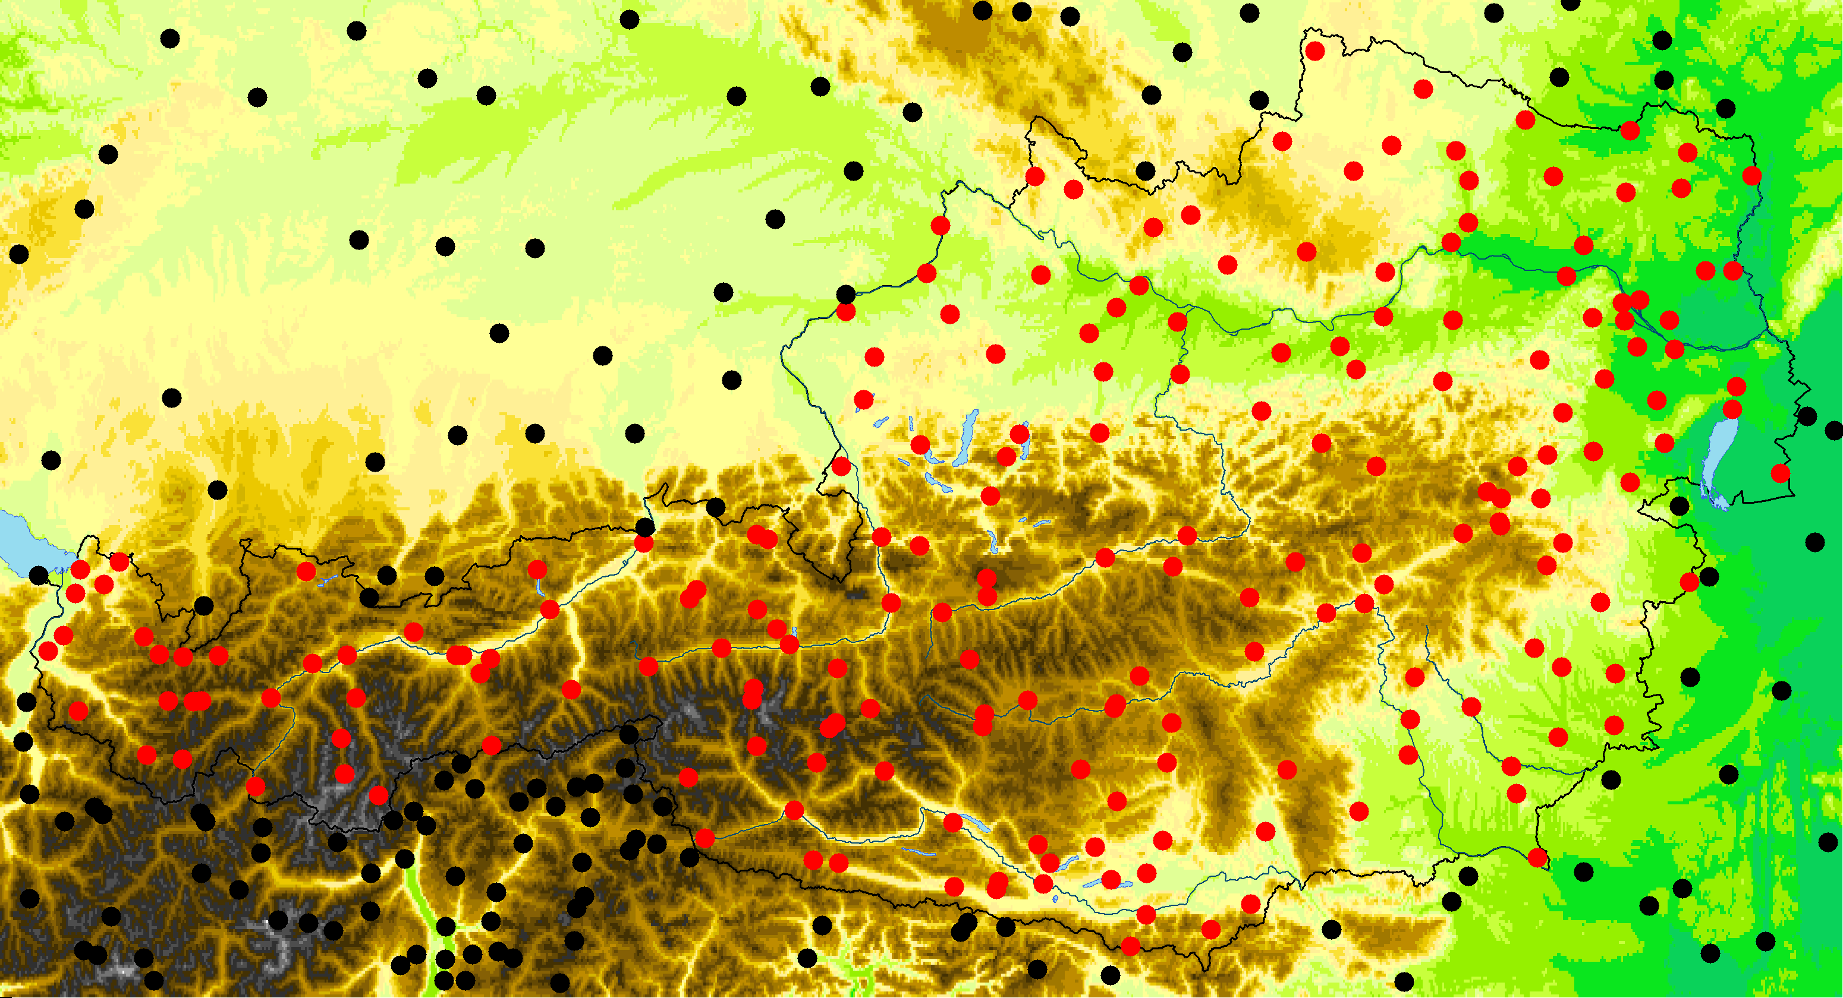
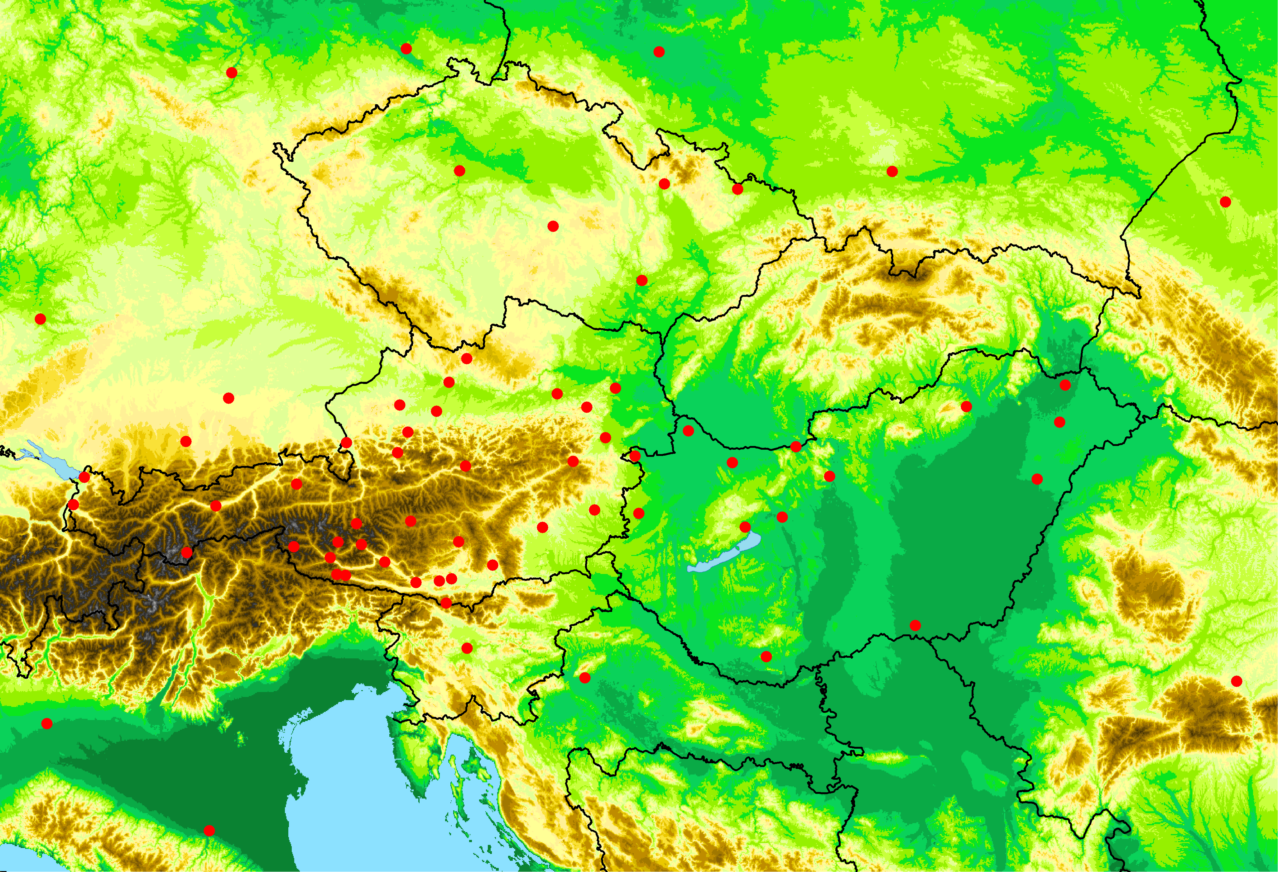
II.: Station systems for homogenization
It's not just Austrian stations that are involved in homogenization
Use of several stations from the region, from which daily data series are available from the 1850s + 9 stations with only monthy data
For MISH modeling, an additional 134 stations from neighboring countries for the period 1981-2024
Source of data: national open data portals, ECAD
Final MASH systems
Monthly
Daily
MASH1m (1851-2024): 67 stations
MASH2m (1871-2024): 91 stations
MASH3m (1881-2024): 125 stations
MASH4m (1931-2024): 153 stations
MASH5m (1951-2024): 179 stations
MASH6m (1981-2024): 232 stations
MASH6m(mod): 1981-2024: 366 stations
MASH1d (1851-2024): 33 stations
MASH2d (1895-2024): 47 stations
MASH3d (1936-2024): 104 stations
MASH4d (1951-2024): 170 stations
MASH5d (1981-2024): 223 stations
Stations for MISH modeling: 339 stations
MASH1m (1851-2024): 67 stations

Slide 11
Creation of the ATCLIM database
I.: Collecting of the data series
II.: Station systems for homogenization (monthly and daily)
III.: Homogenization of monthly and daily data series

Slide 12
III.: Homogenization of monthly data series
Homogenization of monthly series: additive model (significance level: 0.05)
The most important verification statistics in annual mean temperature (MASHm systems):
 | MASH1m (1851–2024) | MASH2m (1871–2024) | MASH3m (1981–2024) | MASH4m (1931–2024) | MASH5m (1951–2024) | MASH6m (1981–2024) | MASH6m(mod) (1981–2023)
Number of series | 67 | 91 | 125 | 153 | 179 | 232 | 366
Critical value: (significance level: 0.05) | 22.19 | 22.06 | 22.05 | 21.60 | 21.40 | 20.86 | 20.86
Test Statistics Before Homogenization | 1289.91 | 1411.89 | 1305.45 | 874.72 | 475.29 | 259.50 | 272.96
Test Statistics After Homogenization | 26.40 | 25.28 | 25.66 | 24.82 | 25.01 | 22.00 | 22.61
Relative Modification of Series | 0.55 | 0.51 | 0.49 | 0.36 | 0.31 | 0.23 | 0.28
Representativity of station network | 0.85 | 0.87 | 0.87 | 0.89 | 0.90 | 0.91 | 0.91

Slide 13
III.: Homogenization of daily data series
Homogenization of daily series based on the MASHm results
The most important verification statistics in annual mean temperature (MASHd systems):
 | MASH1d (1851–2024) | MASH2d (1895–2024) | MASH3d (1936–2024) | MASH4d (1951–2024) | MASH5d (1981–2024)
Number of series | 33 | 47 | 104 | 170 | 223
Critical value: (significance level: 0.05) | 22.19 | 21.93 | 21.53 | 21.40 | 20.86
Test Statistics Before Homogenization | 1110.09 | 1443.01 | 857.12 | 485.12 | 265.55
Test Statistics After Homogenization | 26.94 | 27.15 | 26.35 | 24.97 | 22.27
Relative Modification of Series | 0.50 | 0.47 | 0.38 | 0.31 | 0.24
Representativity of station network | 0.82 | 0.84 | 0.88 | 0.90 | 0.91

Slide 14
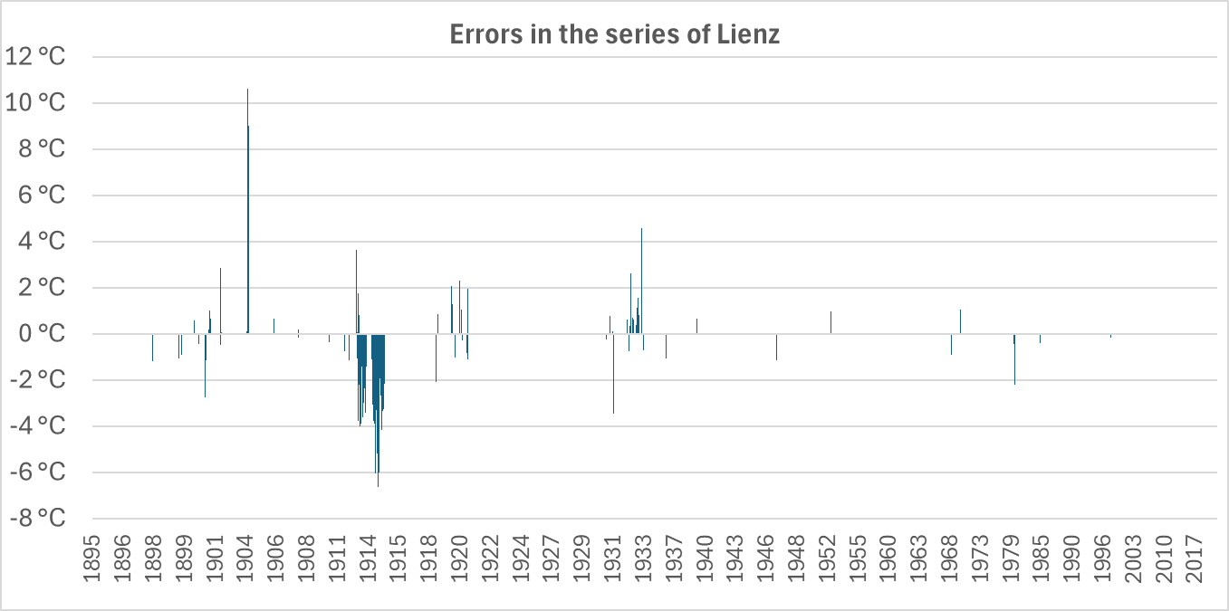
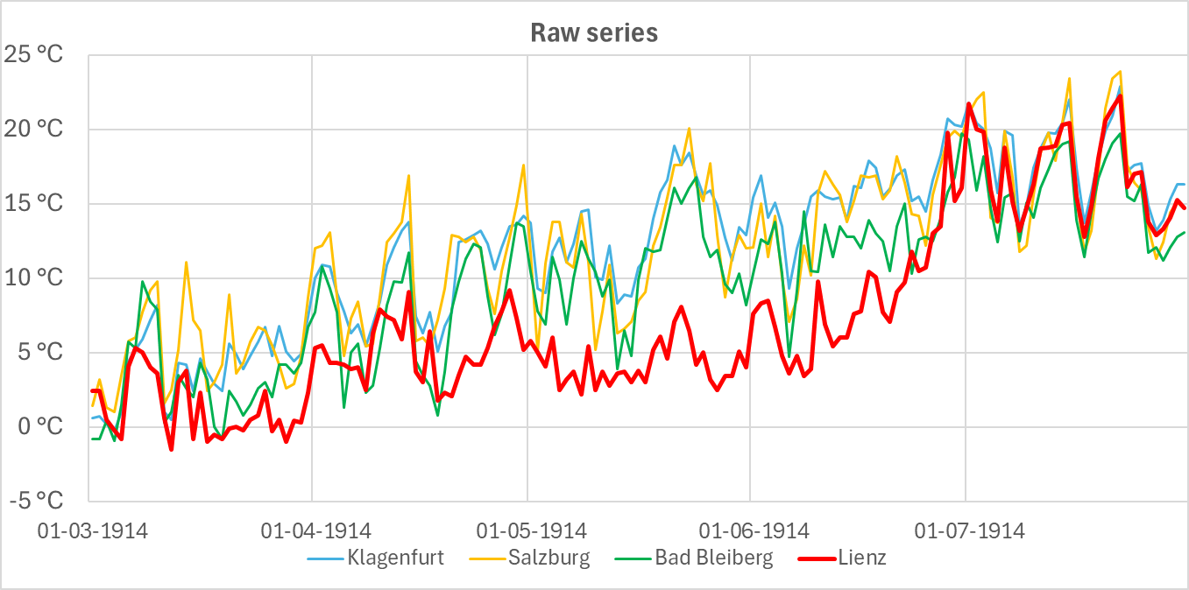
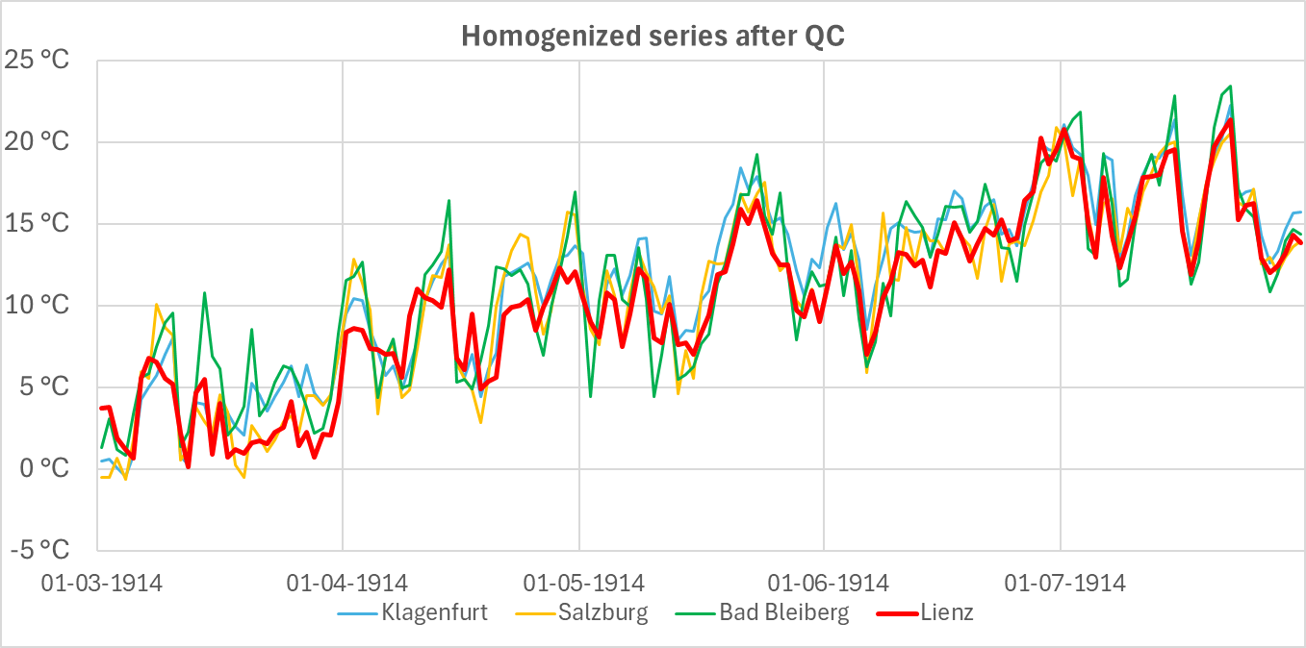
Errors
The MASH procedure includes a QC
MASH detected many errors at the Lienz station in 1914

Slide 15
Creation of the ATCLIM database
I.: Collecting of the data series
II.: Station systems for homogenization (monthly and daily)
III.: Homogenization of monthly and daily data series
IV. Modeling of climate statistical parameters with MISH

Slide 16
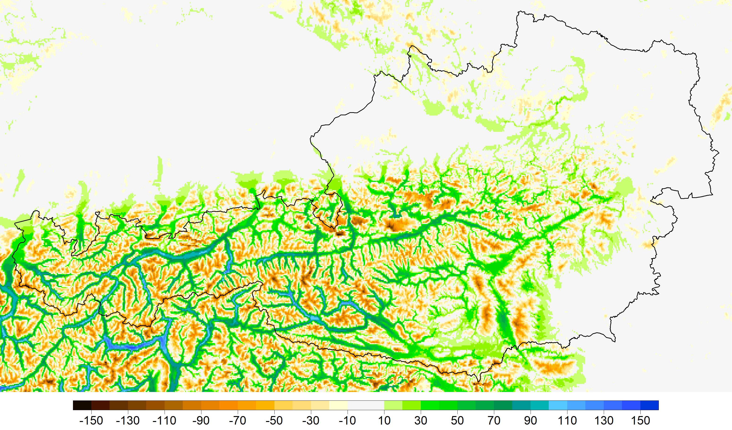
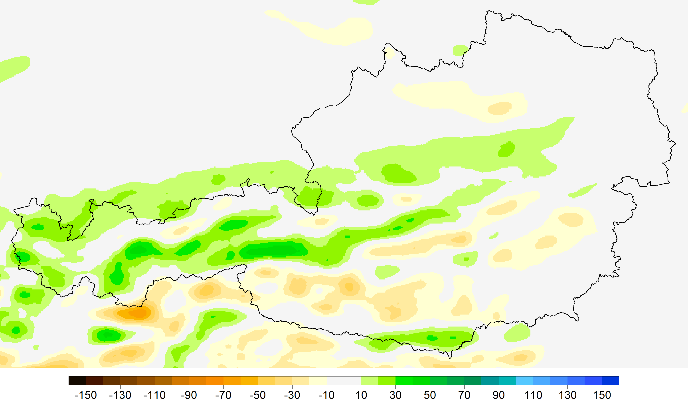
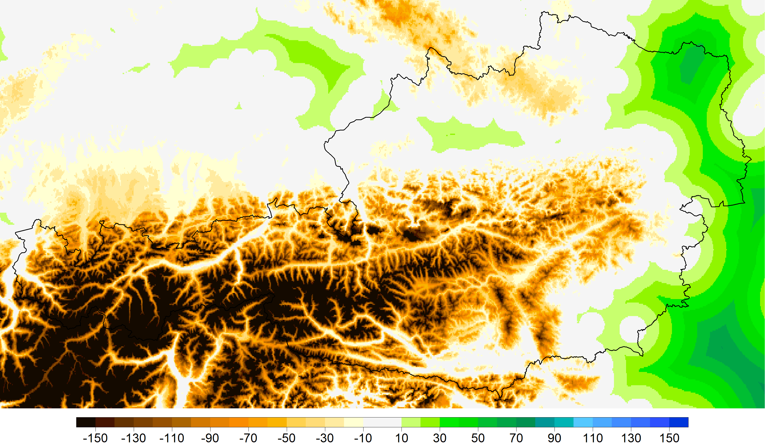
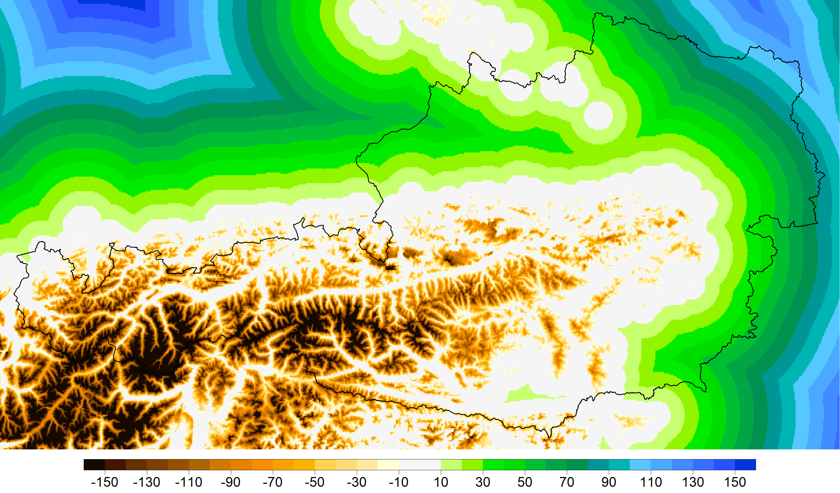
IV.: Modeling of climate statistical parameters with MISH
Using additive model for MISH modeling
Time period: 1981–2024
Number of stations: 339
In addition to height, 19 model variables (MV) were used, of which 15 were AURELHY principal components.
MV-1
MV-2
MV-16
MV-17

Slide 17
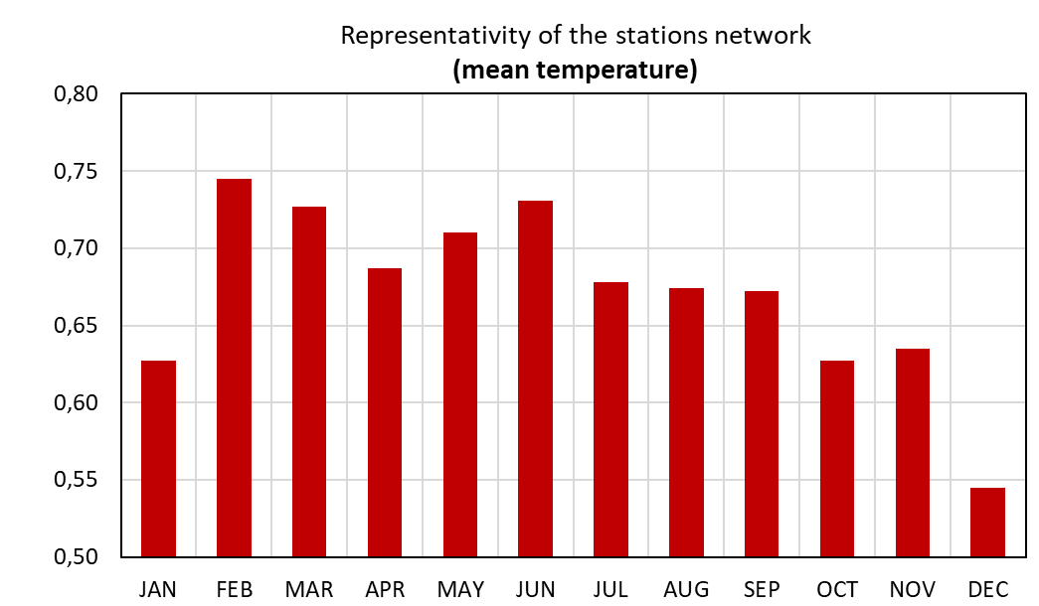
Results of MISH modeling
In MISH modeling, the summer period was basically determined by altitude
In the winter period, however, other model variables used in the modeling were also important
The modeling part of MISH includes a benchmark study. The cross-validation test is a possibility to evaluate the interpolation methods. That is interpolation between the station data series and examination of the root mean square interpolation errors or the representativity. The strength of representativity depends on the predictand-predictors system
The monthly modeled representativity values are generally between 0.6 and 0.7

Slide 18
Creation of the ATCLIM database
I.: Collecting the of data series
II.: Station systems for homogenization (monthly and daily)
III.: Homogenization of monthly and daily data series
IV. Modeling of climate statistical parameters with MISH
V. Harmonization of the monthly and daily MASH systems

Slide 19
V.: Harmonization of the monthly and daily MASH systems
We already have daily homogeneous, quality-controlled data series
However, we have more monthly information than daily
The aim is for the gridded daily data series to also contain more information derived from monthly station values
Therefore, first, the daily homogeneous, quality-controlled data series were interpolated with MISH into those points for which only monthly data were available in the MISHm systems
These daily values were then adjusted to the known monthly raw values for each month and each stations for which monthly data was available in the MASHm systems
Finally, the original raw daily data were inserted, if they were
An example:
The Sonnblick station began measurements in 1886
For monthly MASH systems, it is in MASH3m, which began in 1881
For daily MASH systems, however, it is in MASH2d, which began in 1895, because there are too long gap for it to be in the first daily MASH system
Finally, the original daily data for the period 1886-1894 were inserted in the combined daily-monthly data series (MASHdm)

Slide 20
V.: Harmonization of the monthly and daily MASH systems
Homogenization of the daily-monthly combined series based on the MASHm systems
The most important verification statistics in annual mean temperature (MASHdm systems):
 | MASH1dm (1851–2024) | MASH2dm (1871–2024) | MASH3dm (1981–2024) | MASH4dm (1931–2024) | MASH5dm (1951–2024) | MASH6dm (1981–2024)
Number of series | 58 | 82 | 116 | 144 | 170 | 223
Critical value: (significance level: 0.05) | 22.19 | 22.06 | 22.05 | 21.60 | 21.40 | 20.86
Test Statistics Before Homogenization | 1194.41 | 1333.13 | 1265.00 | 896.64 | 485.12 | 265.55
Test Statistics After Homogenization | 26.12 | 25.86 | 25.69 | 24.74 | 24.97 | 22.27
Relative Modification of Series | 0.56 | 0.52 | 0.49 | 0.36 | 0.31 | 0.24
Representativity of station network | 0.85 | 0.87 | 0.87 | 0.89 | 0.90 | 0.91

Slide 21
Creation of the ATCLIM database
I.: Collecting the data series
II.: Station systems for homogenization (monthly and daily)
III.: Homogenization of monthly and daily data series
IV. Modeling of climate statistical parameters with MISH
V. Harmonization of the monthly and daily MASH systems
VI. Spatial interpolation for Austria

Slide 22
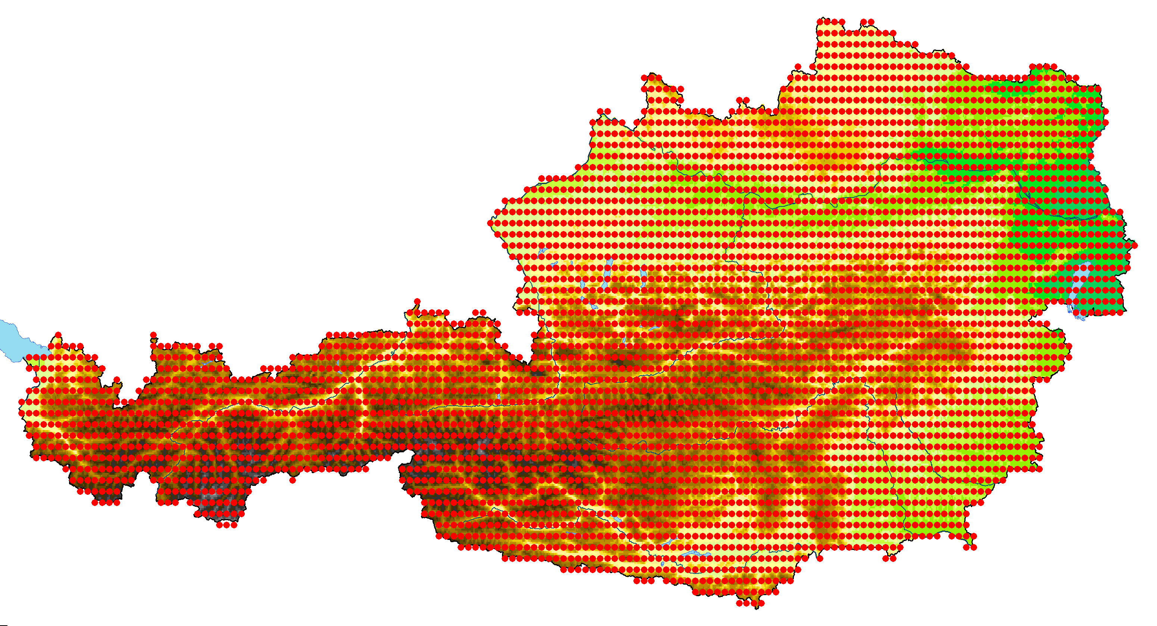
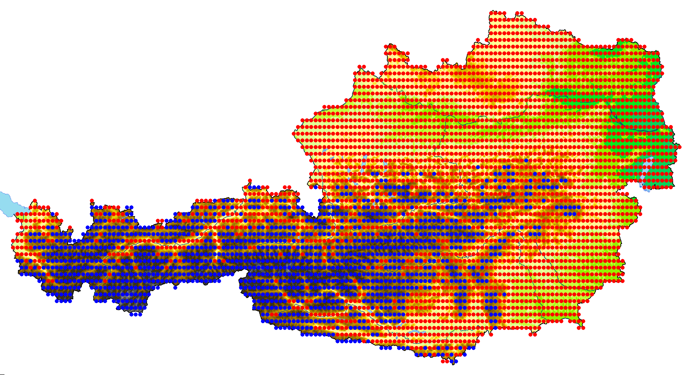
VI. Spatial interpolation for Austria
Interpolation of the homogenized, quality–controlled and completed daily series with MISH to a grid with the resolution of 0.05°×0.05°, which means 4214 total grid points in the case of Austria.
Number of stations used in gridding: 1851-1870: 39 1871-1880: 63 1881-1930: 97 1931-1950: 125 1951-1980: 151 1981-2024: 204
Austria is a mountainous country, so mountainous and lowland areas are analyzed separately. The boundary is 1200 meters above sea level.

Slide 23
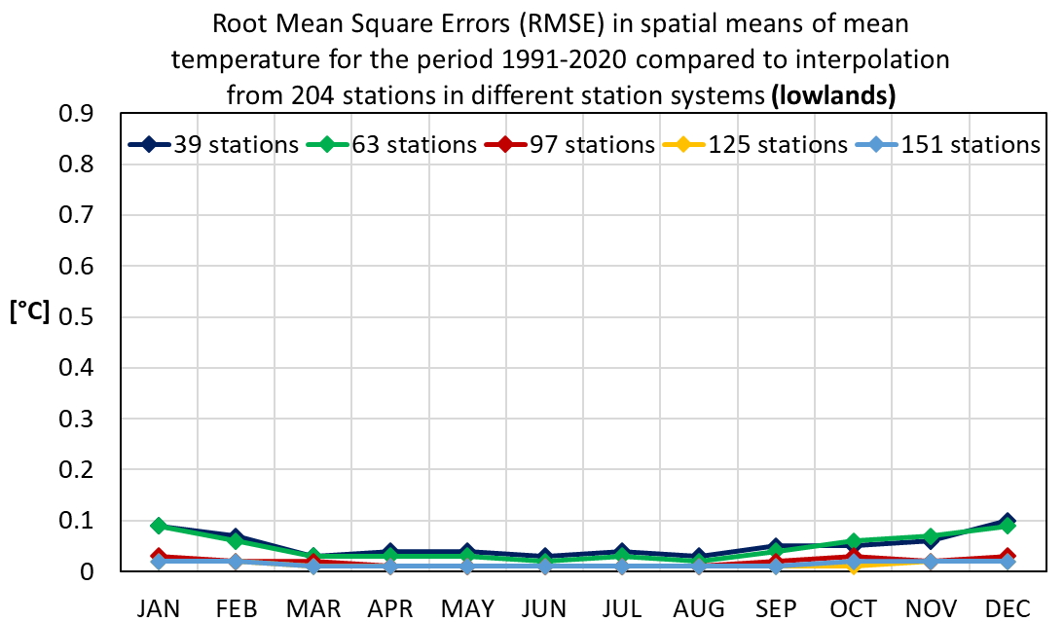
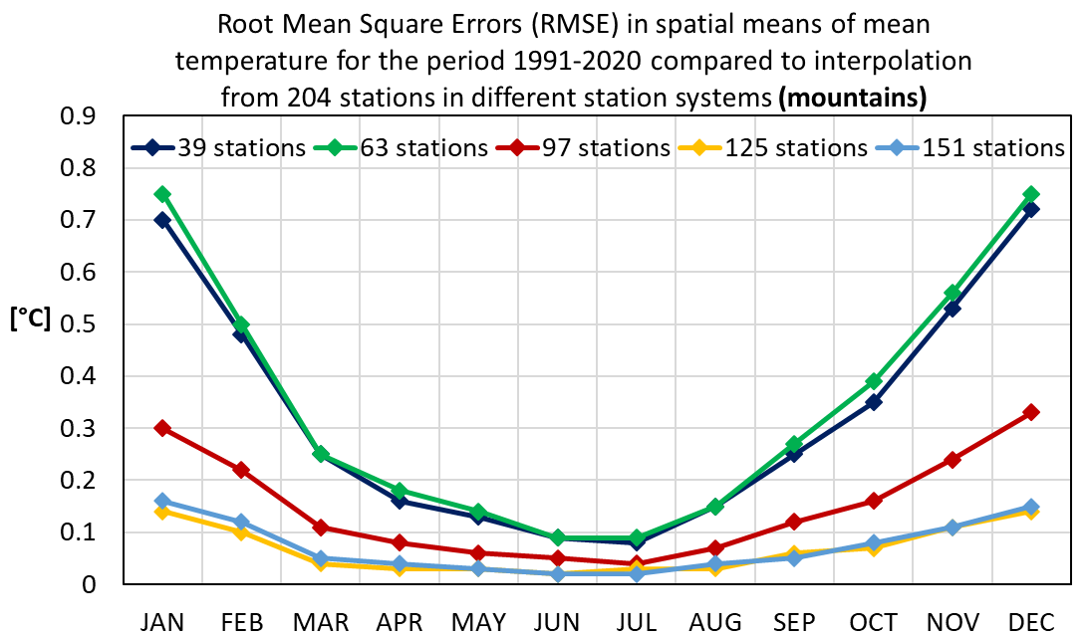
Differences in spatial means at different station density
In the lowlands, the RMSE values are very low every month, within 0.1 °C.
In the mountains, we also see very low values during the summer period. In winter, the values are slightly higher, but the maximum still remains below 0.8 degrees.
The cold air-pool weather conditions are common during the winter months, which cause inversion. Using fewer mountain stations results in higher RMSE values. It also shows why mountain measurements are important.

Slide 24
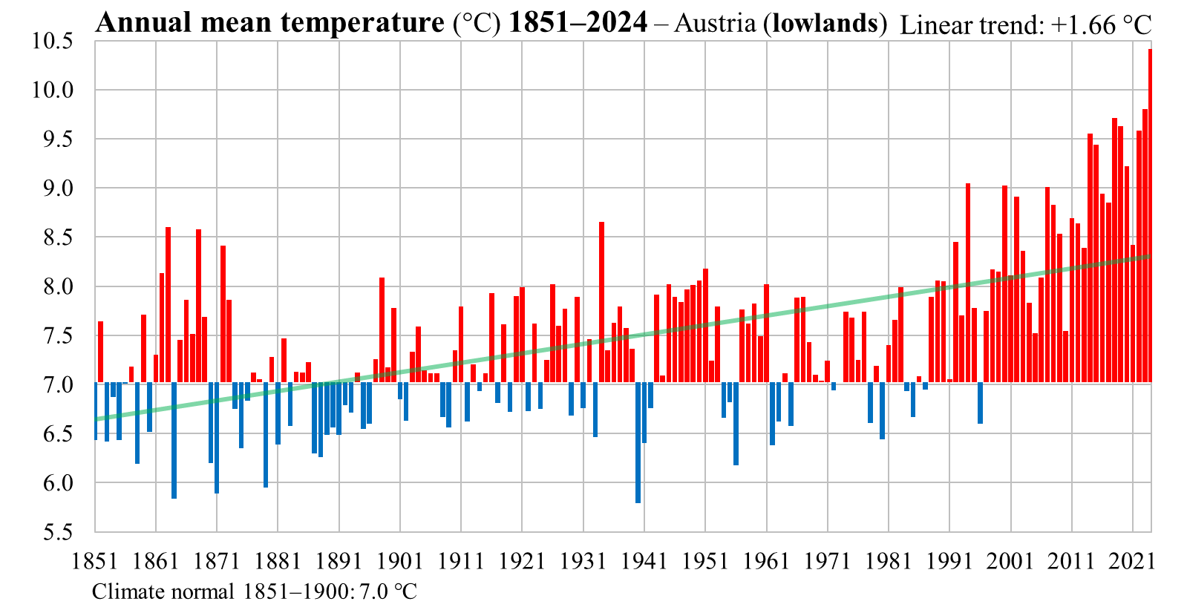
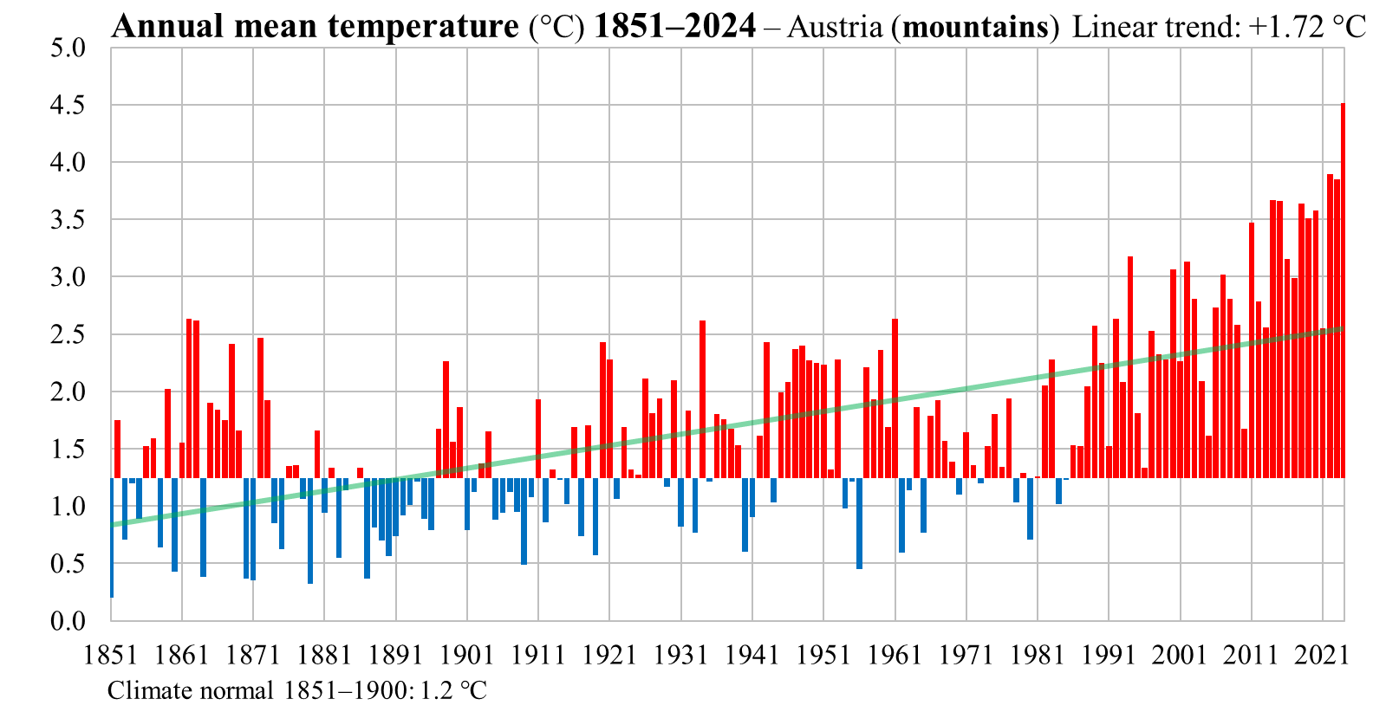
Spatial means of annual temperature in Austria
The warming is significant in the lowland and mountainous areas in the period 1851-2024
The detected linear trend is slightly higher in mountainous areas
The warmest year was 2024. The coldest year in the lowlands was 1940, and in the mountains it was 1851
This century has not yet seen a colder year than the mean for 1851–1900. The last time this happened on the lowlands was in 1996, and in the mountains in 1985

Slide 25
Monthly, seasonal and annual extremes in spatial means from 1851 to 2024, and the 1851–1900 and 1991–2020 climate normals

Slide 26
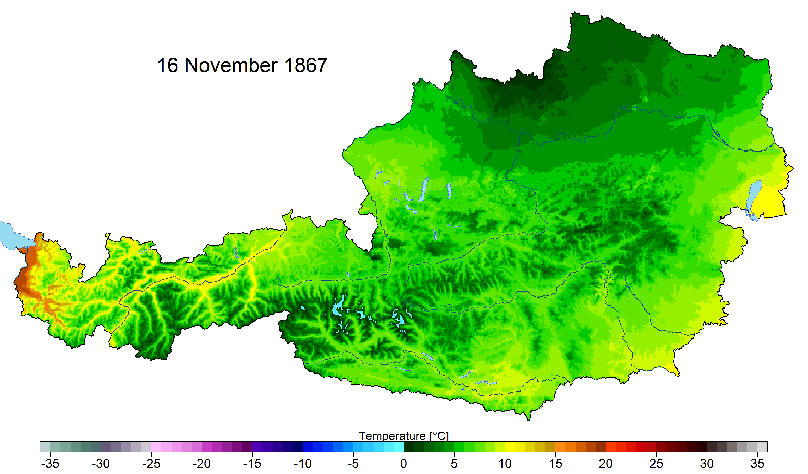
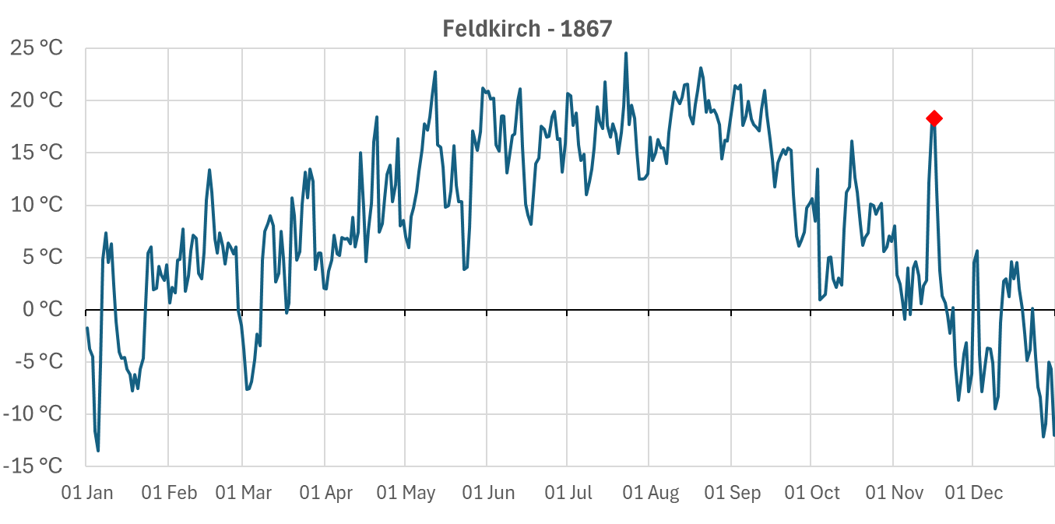
There was a very intense Föhn event in the Rhine Valley, which caused very high daily mean temperatures
It was summery temperatures in Feldkirch

Slide 27
Homogeneity of the ATCLIM and HISTALP station data series
Data series for 29 Austrian stations were downloaded from the HISTALP website
Verification statistics were calculated using MASH for two periods:
1856-2024 with 12 stations
1901-2024 with 29 stations
 | HISTALP (1856–2024) | ATCLIM (1856–2024) | HISTALP (1901–2024) | ATCLIM (1901–2024)
Number of series | 12 | 12 | 29 | 29
Critical value: (significance level: 0.05) | 22.08 | 22.08 | 21.93 | 21.93
Winter | 58.32 | 22.05 | 93.27 | 25.67
Spring | 69.41 | 24.62 | 96.77 | 20.96
Summer | 122.46 | 34.26 | 168.83 | 23.84
Autumn | 79.12 | 29.99 | 109.13 | 25.10
Year | 169.95 | 29.35 | 211.14 | 25.67
The average test statistics are very high for the HISTALP data series, while they are much lower for ATCLIM
The mean temperature data series in HISTALP are very inhomogeneous.

Slide 28

Summary
In addition to open data, all of monthly mean temperature data series from Austria has been collected, mostly from yearbooks
The homogenization of monthly and daily data series with MASH resulted in temporally representative data series
Climatic statistical parameters were modeled for Austria using MISH
Daily gridded mean temperature data series were produced using MISH method from 1851 to 2024
Comparison with HISTALP data sets showed much lower test statistics for ATCLIM and large inhomogeneities for HISTALP
The 12th Seminar for Homogenization and Quality Control in Climatological Databases and the 7th Interpolation Conference will be organized in Budapest, at the headquarters of the HungaroMet Hungarian Meteorological Service, and online, from 5 to 7 May 2026.

Slide 29

Thank you for your attention!
E-mail: szentes.o@met.hu

